Slide 1
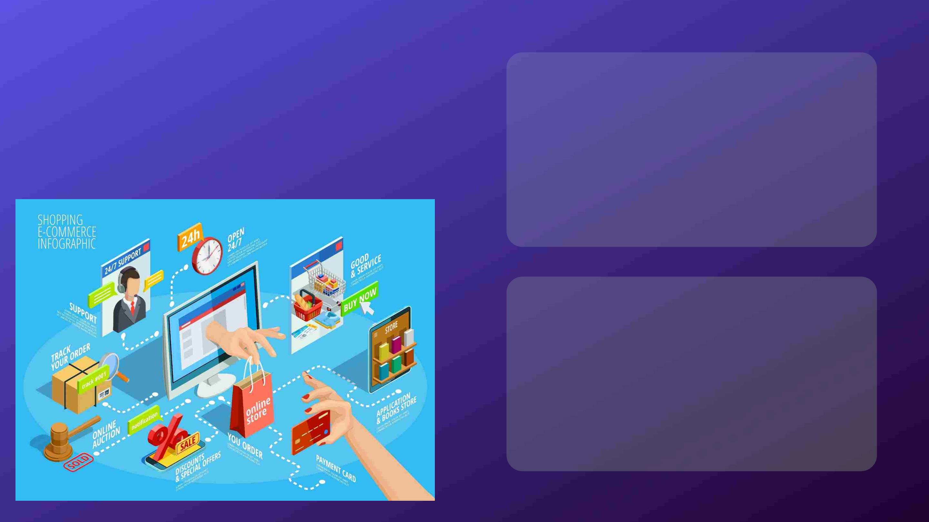
E-Commerce
Website
Presented by
Kushal Pendse
Karri Vinodh
Sisindri Billu
Parth Yelne
Sahil Kakani
Bhavik Bhatt
Mentored By
Gokul Rajagopal
Guided by
Syed Nawas Ahmed

Slide 2

Acknowledgement
We would like to express our sincere gratitude to several individuals and the organization for
supporting us throughout our project work. Firstly, we wish to express our sincere gratitude
to our mentor, Mr. Gokul Rajagopal and technical trainer, Mr. Syed Nawas Ahmed, for their
enthusiasm, patience and immense guidance throughout the whole course of our project.
Without their support and guidance, this project would not have been possible.
We also wish to express our sincere thanks to Cognizant for giving us this very interesting
and interacting project to work on, which helped us learn, grow and experience real-time
project environment.
Finally, last but by no means least, also everyone the team who worked exceptionally hard
to bring the working model to the table.
Thanks for all your encouragement!

Slide 3

Index
• Abstract
• Introduction
• Objectives
• Features
• System Architecture
• Technologies Used
• Software Tools Used
• Microservices
• SQL Server Implementation
• NUnit Testing
• UI Portal

Slide 4

Abstract
The e-commerce industry has seen rapid growth in recent years, providing
businesses with new opportunities to reach customers and grow their sales. In
this presentation, we will explore the key elements of a successful e-commerce
website, including user-friendly design, convenient payment options, and robust
security measures.
We will examine best practices for creating a user-friendly website that
encourages customers to make a purchase. This includes clear product
descriptions, high-quality images, and an easy-to-use navigation. We will also
explore different payment options and secure payment gateways to protect
customer data.

Slide 5

Introduction
E-commerce (electronic commerce) is the buying and selling of goods and services, or the
transmitting of funds or data, over an electronic network, primarily the internet. These business
transactions occur either as business-to-business (B2B), business-to-consumer (B2C), consumer-to
-consumer or consumer-to-business.
The terms e-commerce and e-business are often used interchangeably. The term e-tail is also
sometimes used in reference to the transactional processes that make up online retail shopping.
In the last two decades, widespread use of e-commerce platforms such as Amazon and eBay has
contributed to substantial growth in online retail. In 2011, e-commerce accounted for 5% of total
retail sales, according to the U.S. Census Bureau. By 2020, with the start of the COVID-19
pandemic, it had risen to over 16% of retail sales.

Slide 6

Objective
The project aims to help the people buy products like clothes,
electronic devices, home appliances.
The main idea is to provide a user friendly interface and a
smooth shopping experience for the customers. The goal is to
deploy the application website that can perform all activities,
some of which are logging in successfully, able to add products
in to the cart, view the cart, pay the total amount after any
discounts applied, etc.

Slide 7

Features
• Customer Registration
and login
• Sorting through
products
• Shopping Cart
• Multiple payment
options
• Vendor Registration and
login
• Effective order
management
• Special Offers
• Customer product
review
• Massive range of
products

Slide 8

Frontend Application Technologies
Backend Application Technologies
Angular
HTML
Asp.net Core Web API
ADO.NET
CSS
C#
Bootstrap 5
JavaScript
SQL Server
Node.js

Slide 9
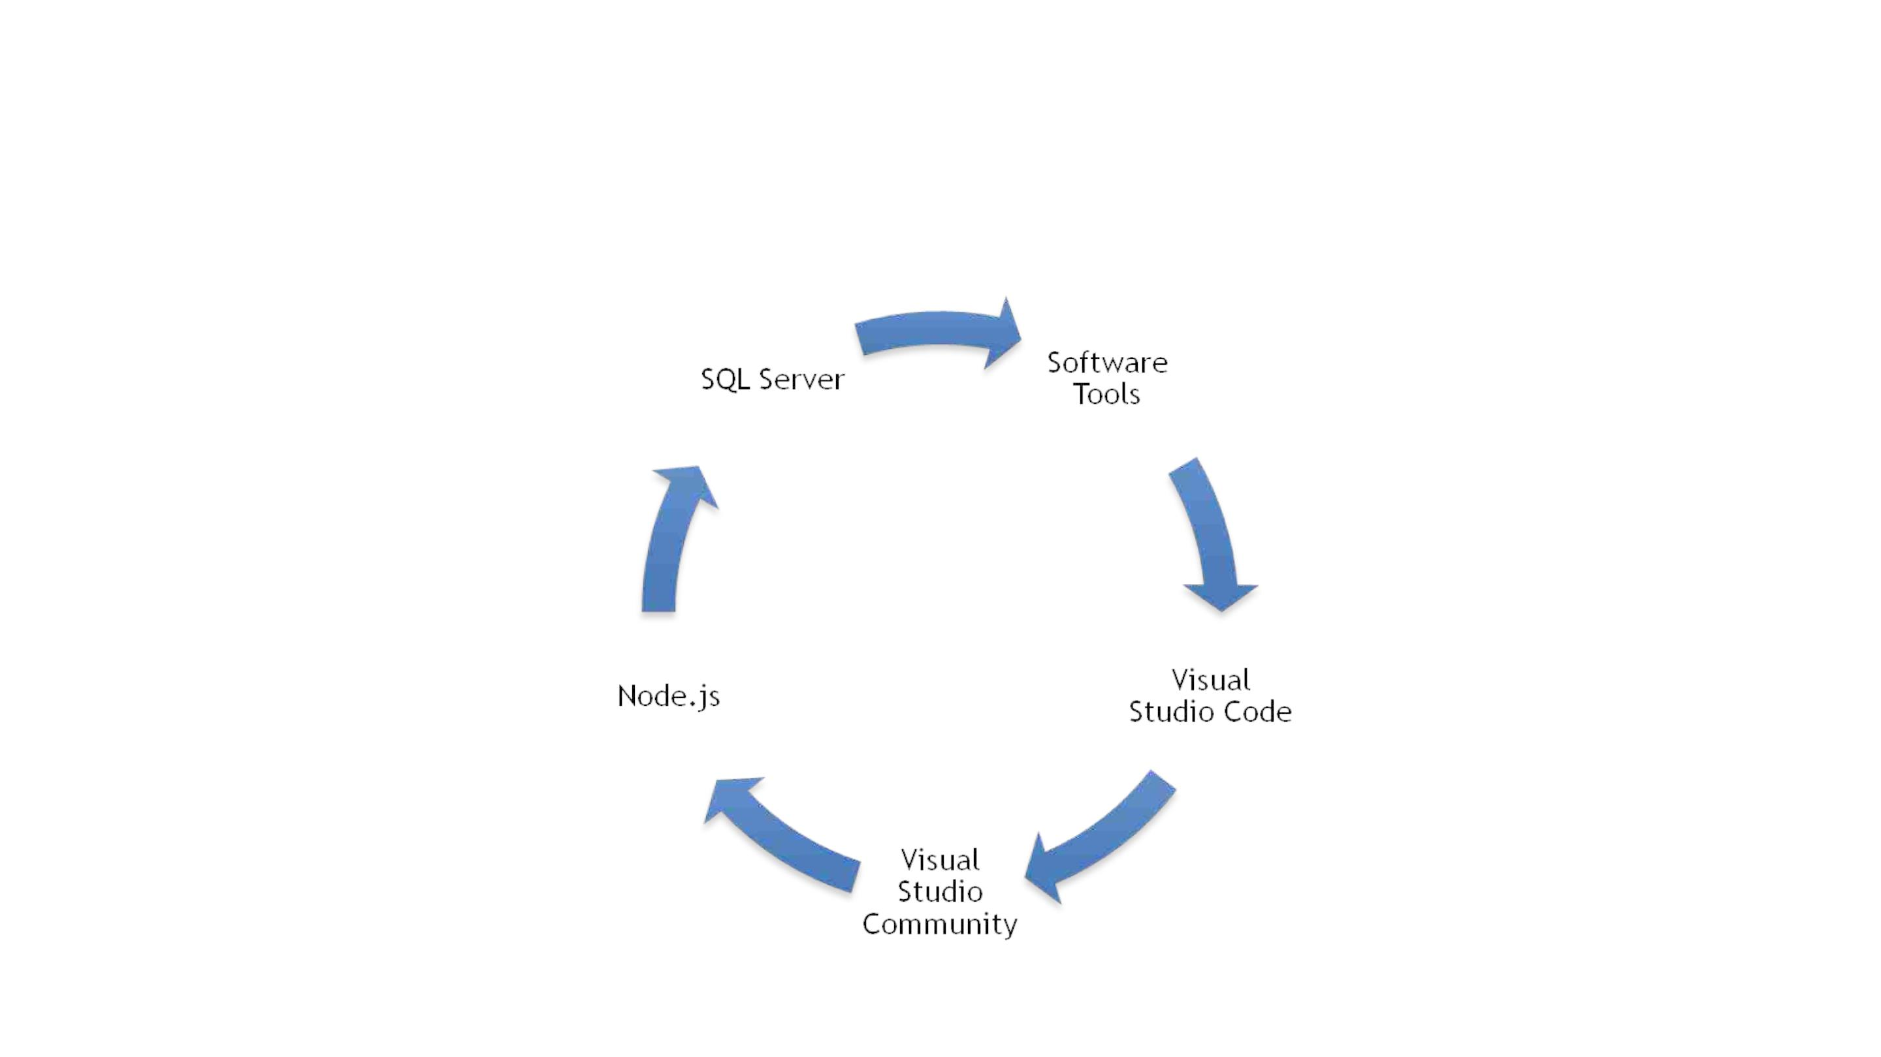
Software Tools Used
02

Slide 10

The microservices covered in our project are
as follows:
• Customer Microservice
• Vendor Microservice
• Products Microservice
• Offer Microservice
Microservices
• Cart Microservice
• Payment Microservice
• Review Microservice

Slide 11
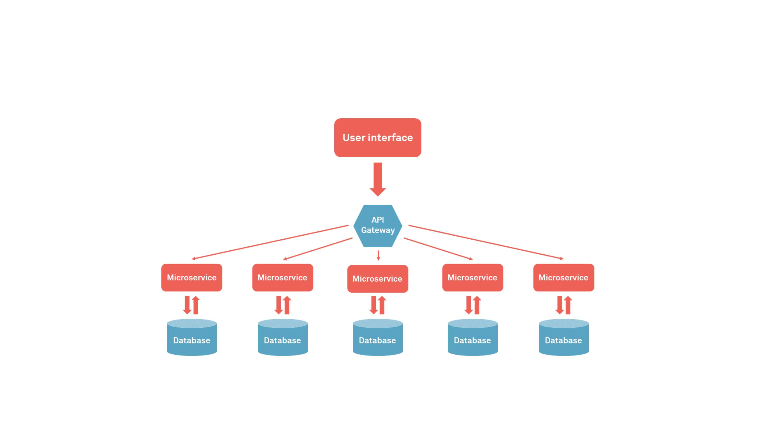
Microservice Architecture

Slide 12

Customer Microservice
• The Customer Microservice in an e-commerce project is responsible for managing all the customer-related
functions of the online store. It provides various features for customers to interact with the e-commerce
platform, including account management.
• This microservice allows customers to create and manage their own accounts, view their order history. It also
provides customers with access to a support system, where they can submit requests or ask questions and
receive quick and efficient responses.
• The Customer Microservice is designed to be highly scalable and efficient, ensuring that customers can
access the information and services they need in a timely manner. By leveraging modern technologies and
best practices, the microservice delivers a seamless and enjoyable customer experience, making it easier for
customers to interact with the e-commerce platform and complete transactions with confidence.

Slide 13
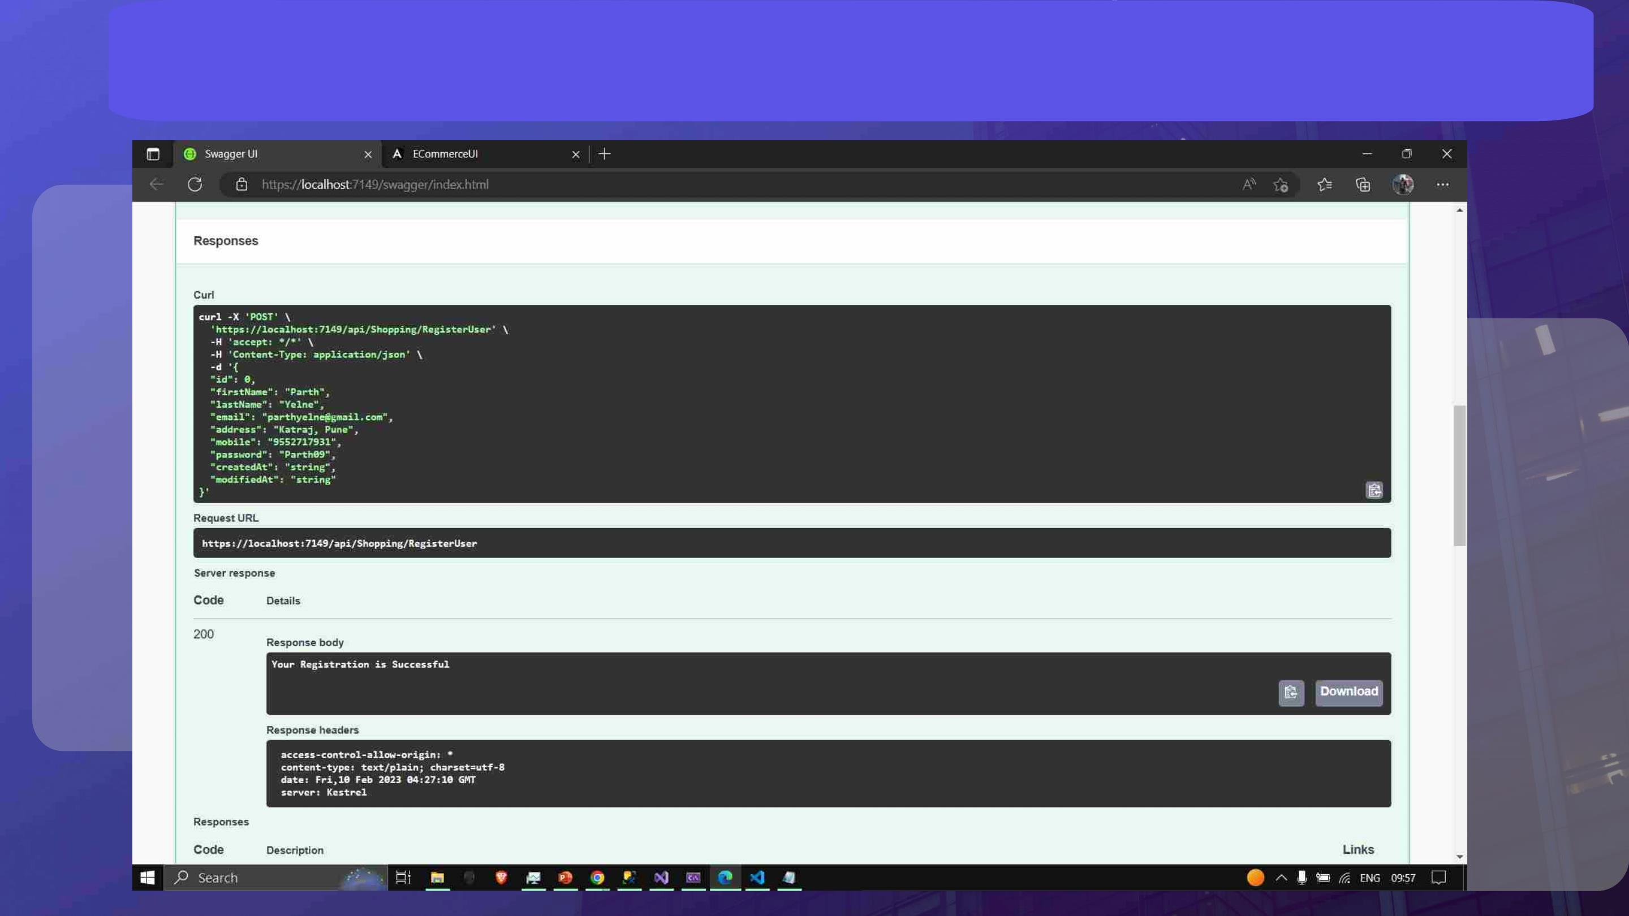
Customer Registration

Slide 14
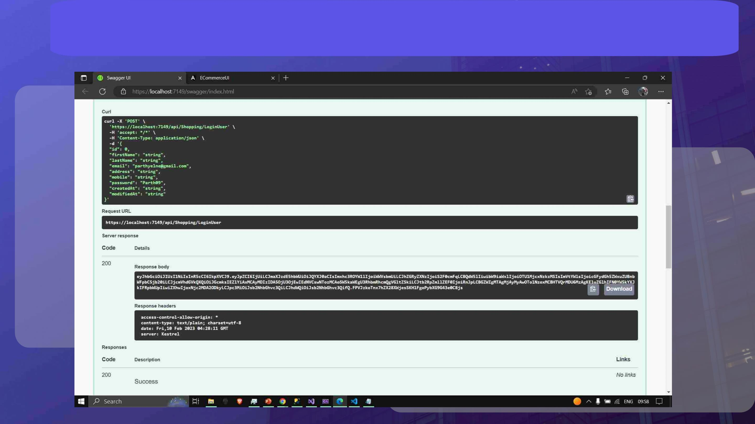
Customer Login

Slide 15

Vendor Microservice
• The Vendor Microservice in an e-commerce project is responsible for managing all the Vendor-related
functions of the online store. It provides various features for customers to interact with the e-commerce
platform, including account management.
• This microservice allows Vendors to create and manage their own accounts, view their order history. It also
provides Vendors with access to a support system, where they can submit requests or ask questions and
receive quick and efficient responses.
• The Vendor Microservice is designed to be highly scalable and efficient, ensuring that Vendors can access the
information and services they need in a timely manner. By leveraging modern technologies and best practices,
the microservice delivers a seamless and enjoyable Vendor experience, making it easier for Vendors to
interact with the e-commerce platform and complete transactions with confidence.

Slide 16
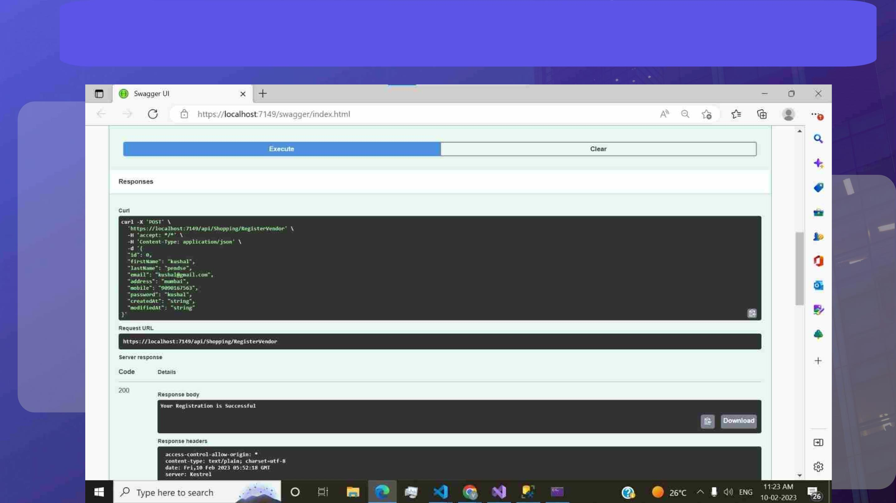
Vendor Registration

Slide 17
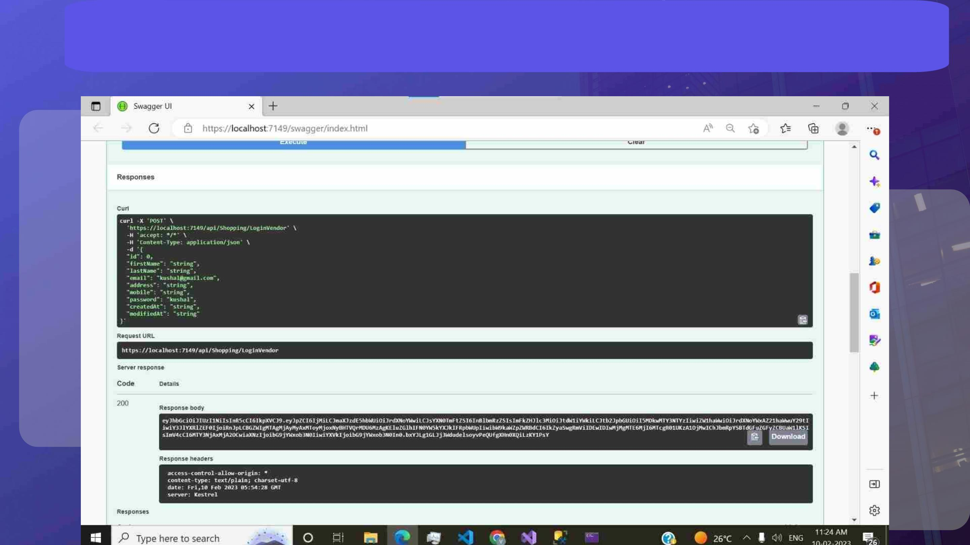
Vendor Login

Slide 18
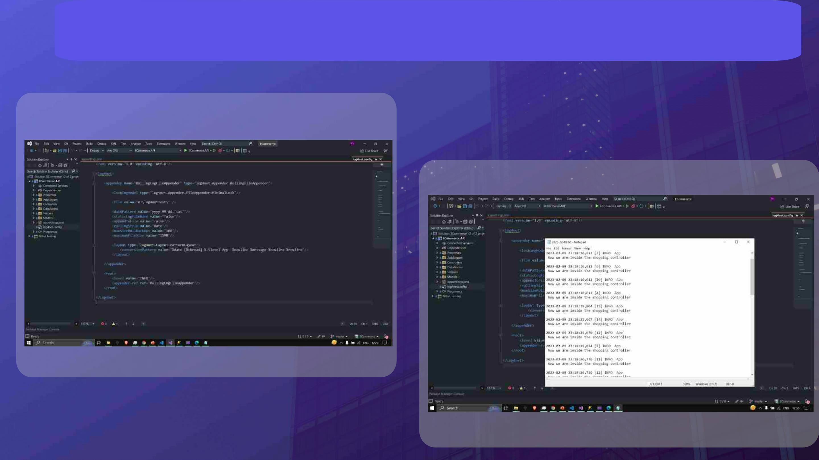
Log4Net Implementation

Slide 19

Products Microservice
• The Products Microservice in an e-commerce project is responsible for managing the catalog of products
offered by the online store. It provides various features for customers to discover, view, and purchase
products, as well as for the back-end administrators to manage the product catalog.
• This microservice allows customers to browse the product catalog, view detailed product information,
including images and descriptions, and add products to their shopping carts. The microservice also provides
back-end administrators with tools to manage the product catalog, including the ability to add new products,
update existing products, and manage product availability and pricing.
• The Products Microservice is designed to be highly performant, providing fast and efficient product search
and retrieval, even as the product catalog grows to include tens of thousands of products. By leveraging
modern technologies and best practices, the microservice delivers a seamless and enjoyable shopping
experience, making it easier for customers to discover, view, and purchase the products they want.

Slide 20
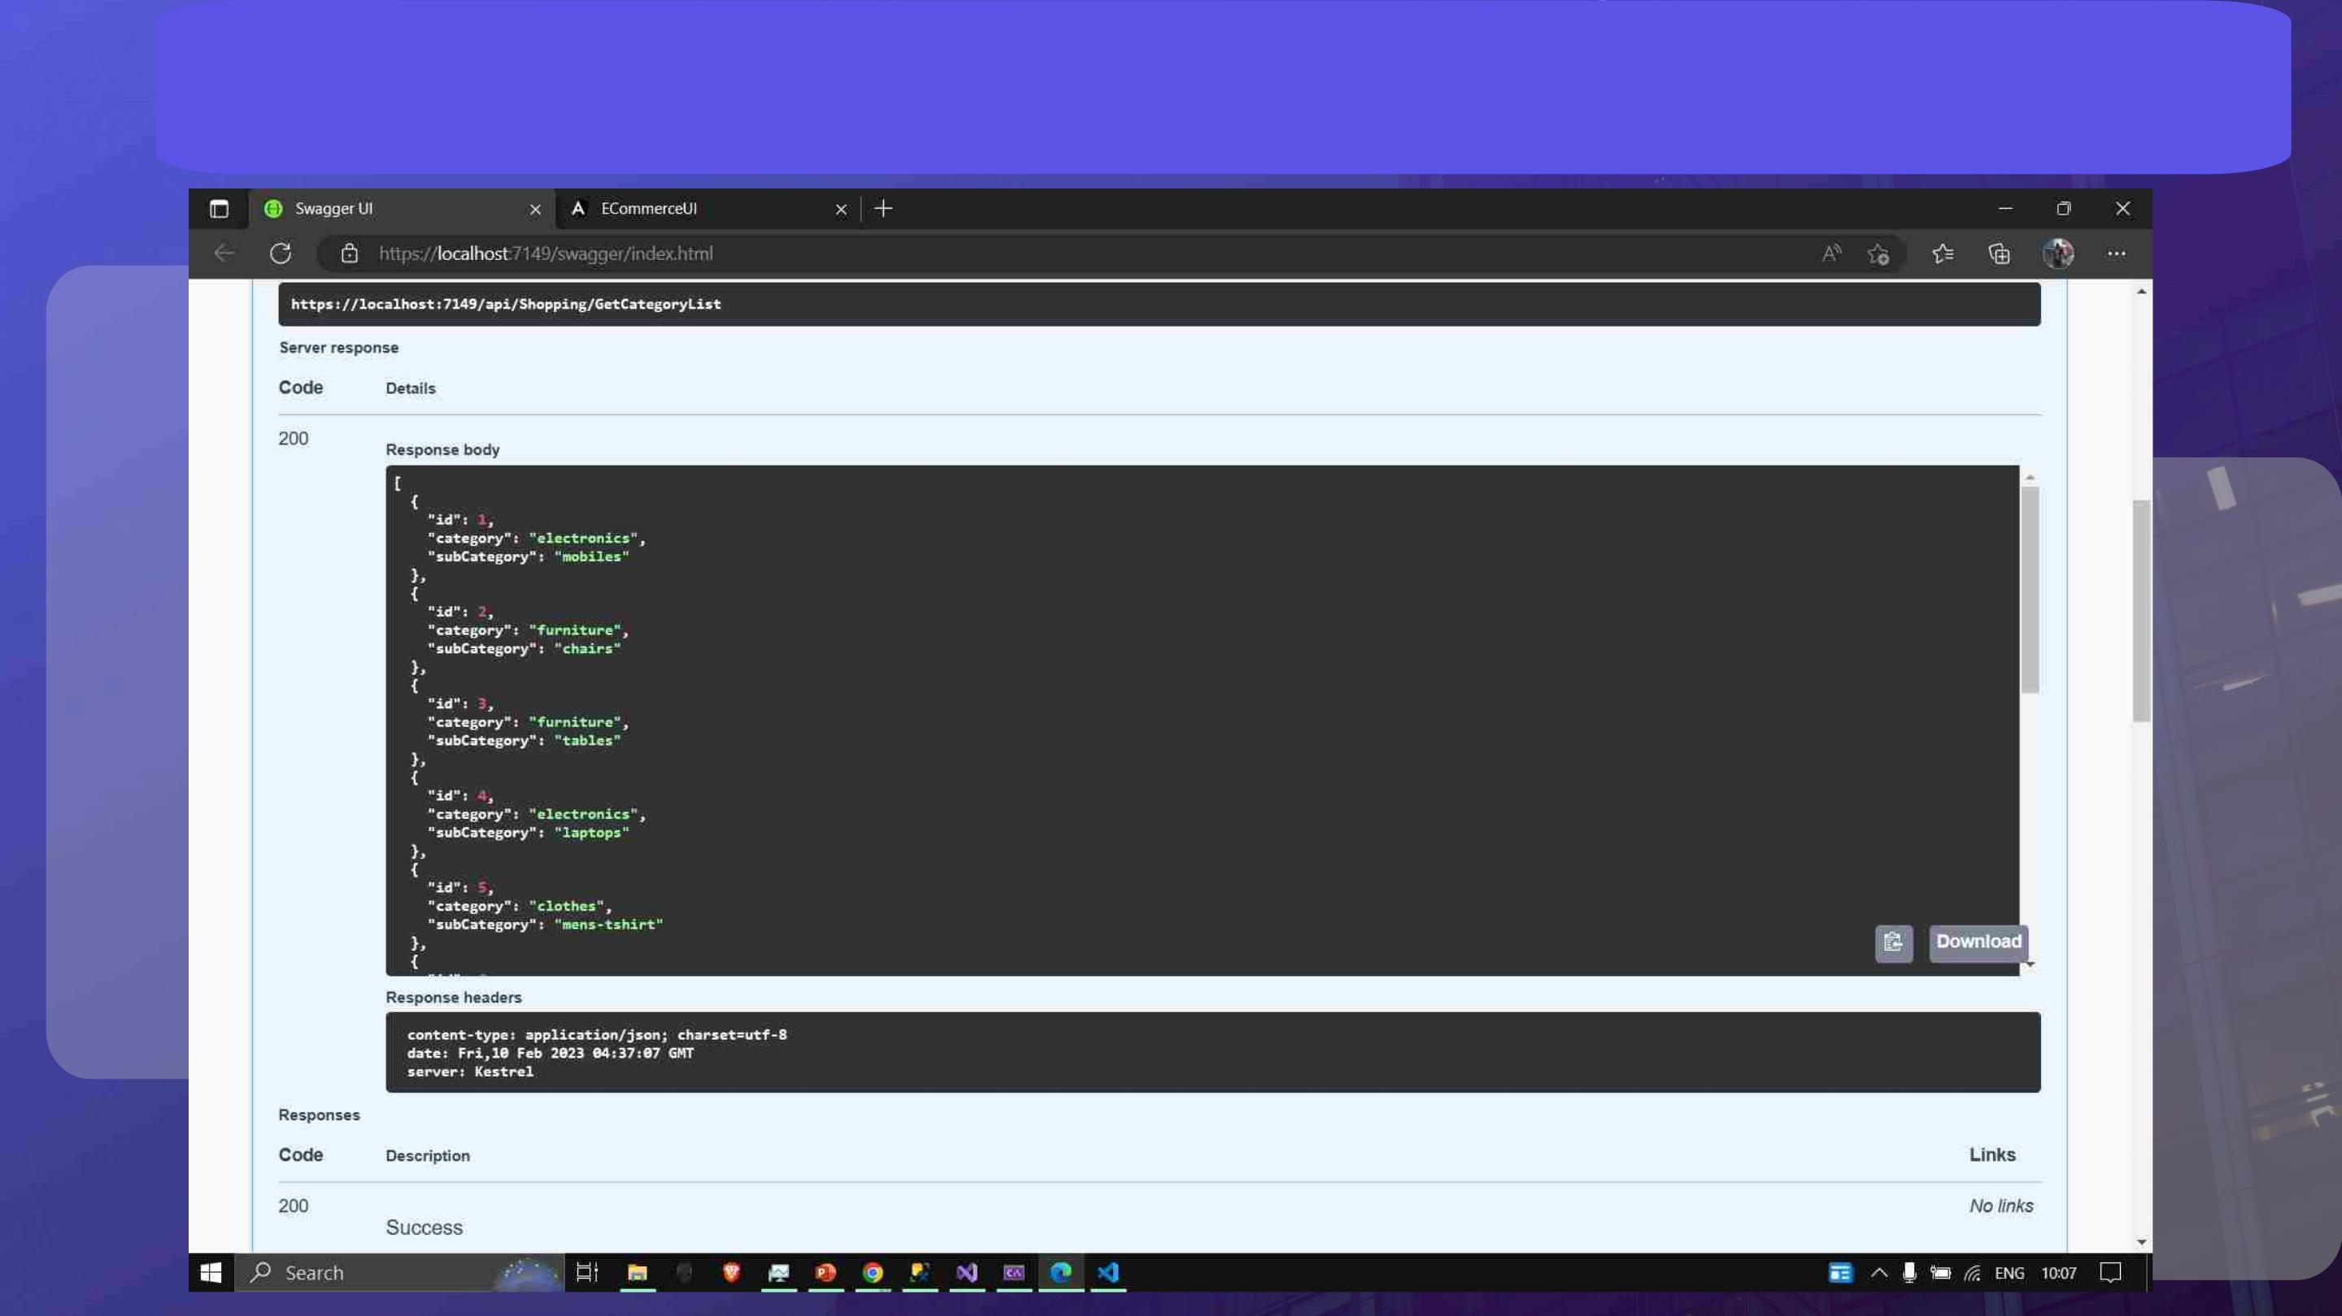
Get Product Category List

Slide 21
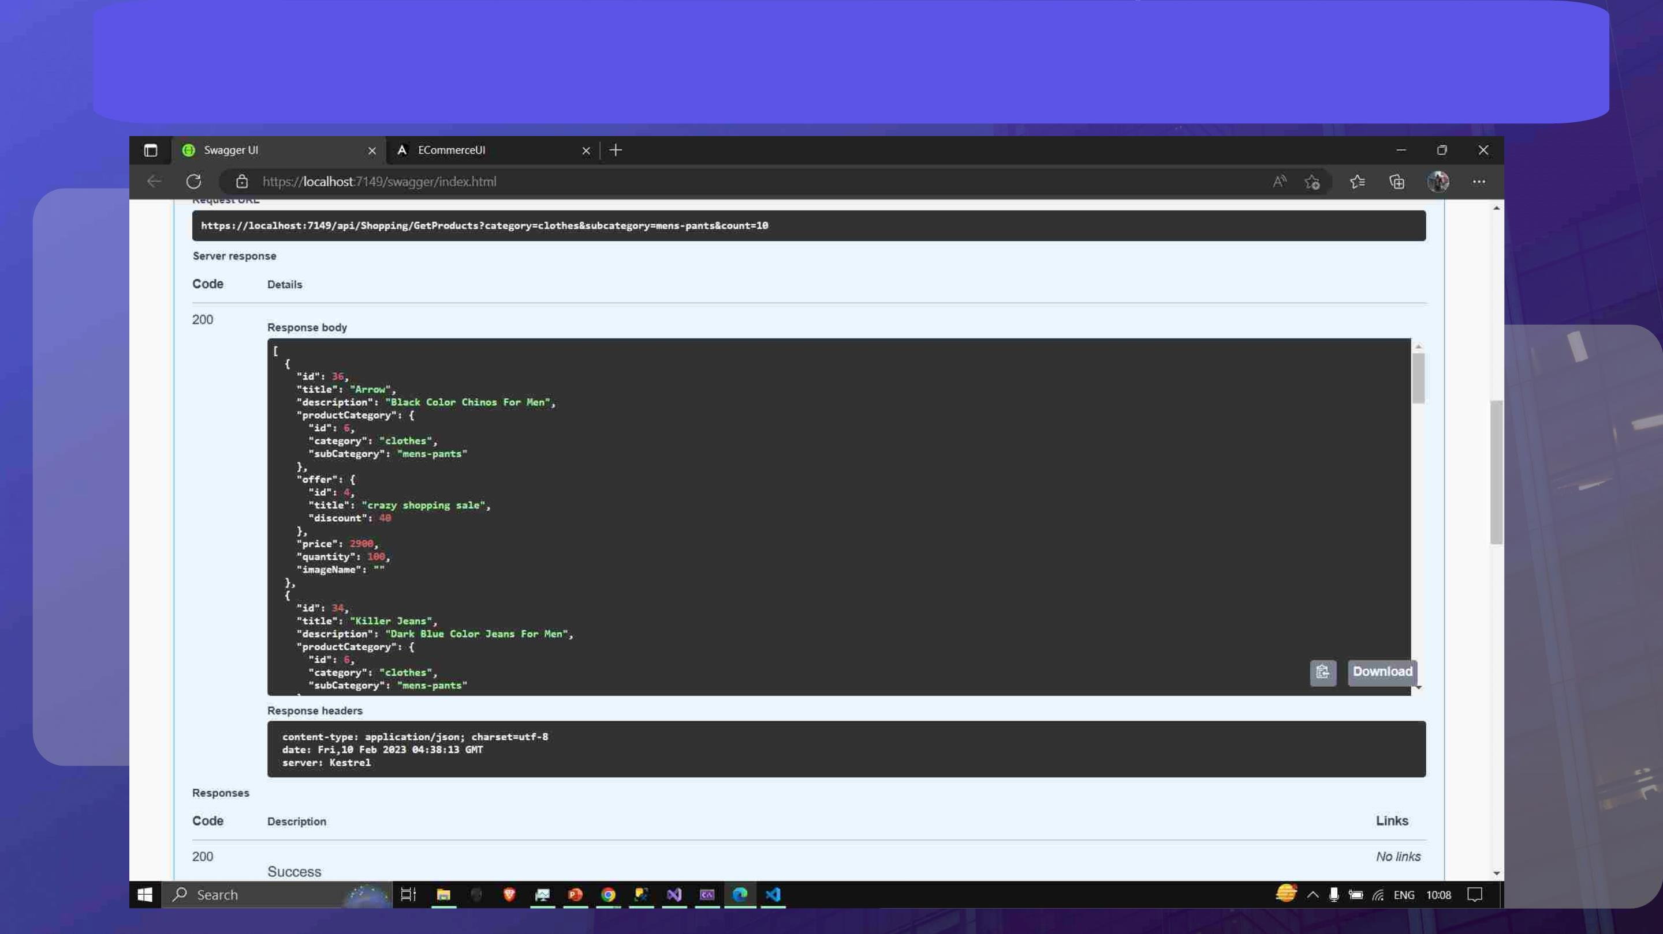
Get Product List

Slide 22
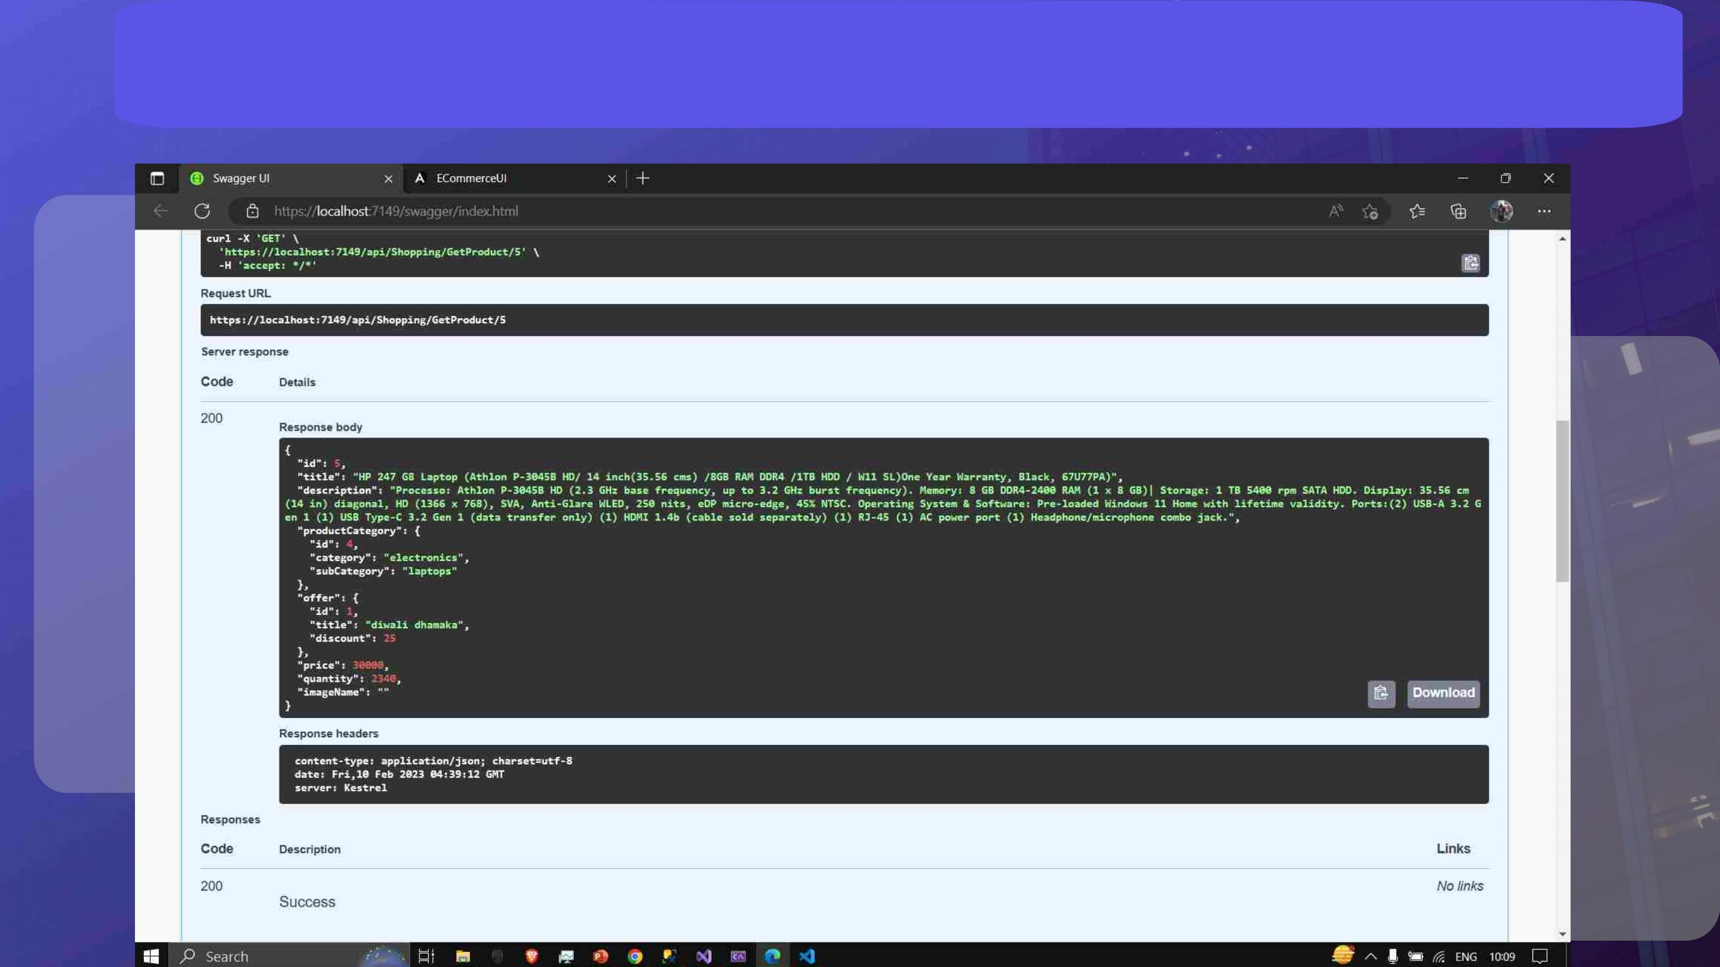
Get Product by Id

Slide 23
Cart Microservice
• The Cart microservice is a crucial component of any e-commerce website, and it is responsible for managing
the shopping cart experience for customers. The Cart microservice allows customers to add and remove items
from their shopping cart, view the contents of their cart, and calculate the total cost of their purchases. It also
allows customers to save their cart for later, so they can return to their shopping session and pick up where
they left off.
• The Cart microservice integrates seamlessly with the rest of the e-commerce website, and it communicates
with other microservices such as the Product microservices to ensure that customers always have access to
the most up-to-date information about the products they want to purchase.
• The Cart microservice is designed to handle high traffic volumes and ensure fast and reliable performance,
even during periods of high demand. It is scalable, so it can grow and evolve along with the e-commerce
website. Overall, the Cart microservice is an essential component of any e-commerce website, and it is
designed to provide customers with a seamless and convenient shopping experience.

Slide 24
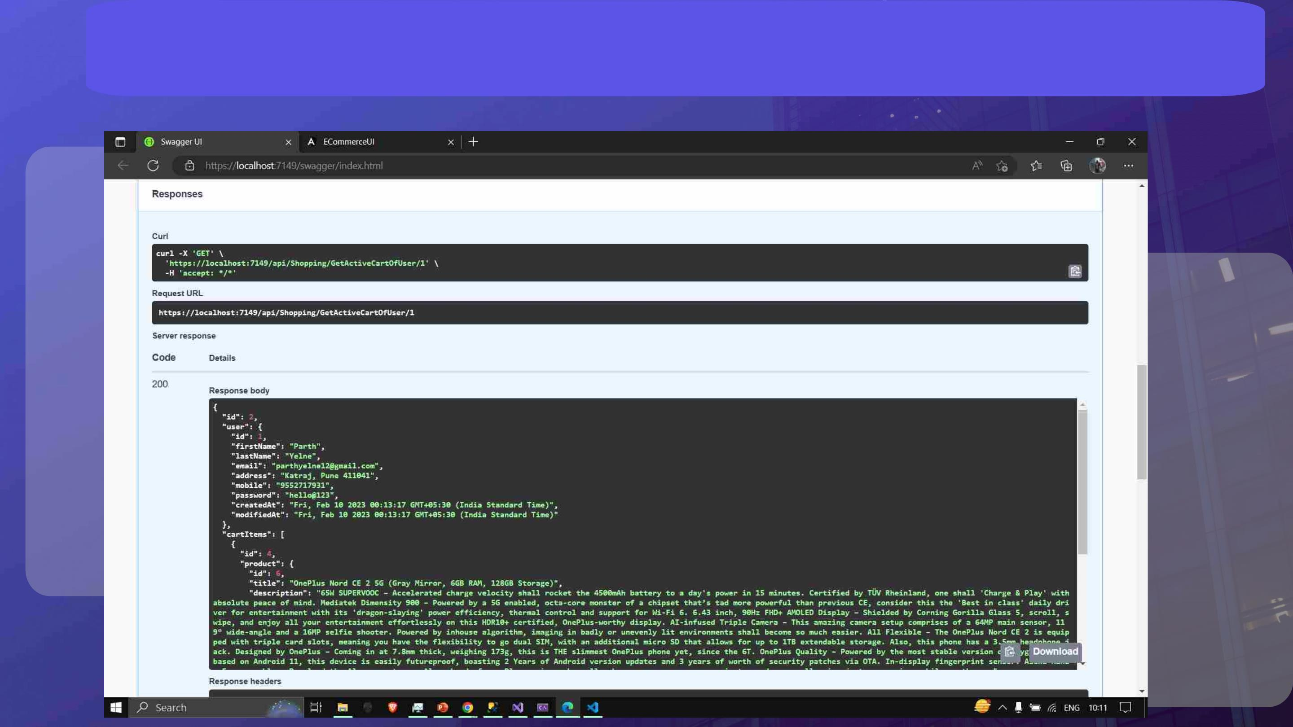
Get Active Cart of User

Slide 25
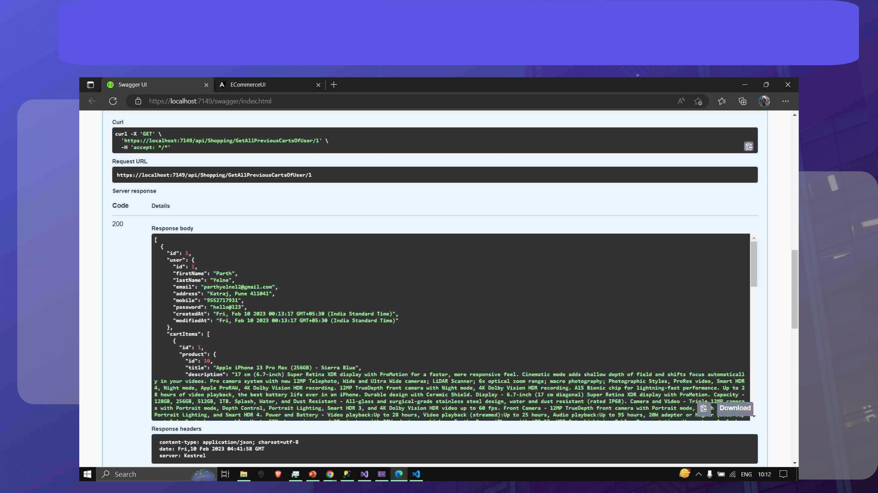
Get all Previous Cart of User

Slide 26
Offer Microservice
• The Offers Microservice in an e-commerce project is responsible for managing and delivering
promotional offers to customers. It provides various features for customers to discover special discounts,
and other offers, as well as for the back-end administrators to create and manage offers.
• The Offers Microservice is designed to be highly flexible, allowing e-commerce administrators to create a
wide variety of promotional offers, and to target specific segments of customers with targeted offers. By
leveraging modern technologies and best practices, the microservice delivers a powerful and effective
tool for driving sales and customer engagement, helping online stores to grow and succeed.

Slide 27

Payment Microservice
• The Payment Microservice in an e-commerce project is responsible for processing and managing customer
payments. It provides various features for customers to securely and conveniently make payments for their
purchases, as well as for the back-end administrators to manage payment transactions.
• This microservice allows customers to make payments using a variety of payment methods, such as credit
cards, debit cards, and digital wallets. It also provides a secure and reliable payment gateway, which encrypts
and transmits payment information. The microservice also provides back-end administrators with tools to monitor
and manage payment transactions.
• The Payment Microservice is designed to be highly secure and compliant, following industry standards and
regulations to ensure the protection of customer payment information. By leveraging modern technologies and
best practices, the microservice delivers a seamless and secure payment experience, helping online stores to
grow and succeed.

Slide 28
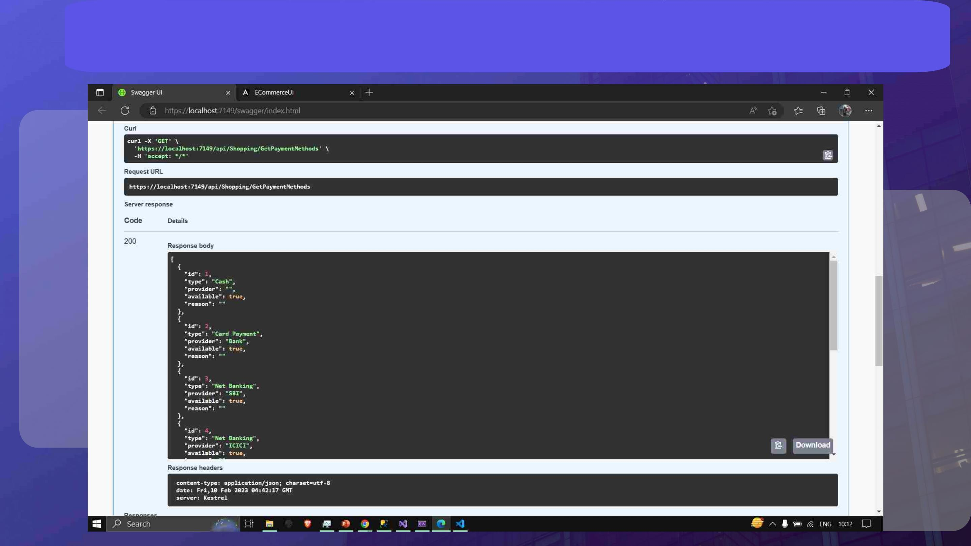
Get Various Payment Methods

Slide 29
Reviews Microservice
• The Reviews Microservice in an e-commerce project is responsible for managing customer reviews for products.
It provides various features for customers to submit and view product reviews, as well as for the back-end
administrators to moderate and manage customer feedback.
• This microservice allows customers to leave detailed reviews for products, including text comments. The
microservice also provides back-end administrators with tools to moderate customer reviews.
• The Reviews Microservice is designed to be highly customizable, allowing online stores to set their own review
guidelines and policies, as well as to configure the display and functionality of the reviews section. By leveraging
modern technologies and best practices, the microservice delivers a powerful and effective tool for managing
customer feedback, helping online stores to improve their products, services, and overall customer experience.

Slide 30
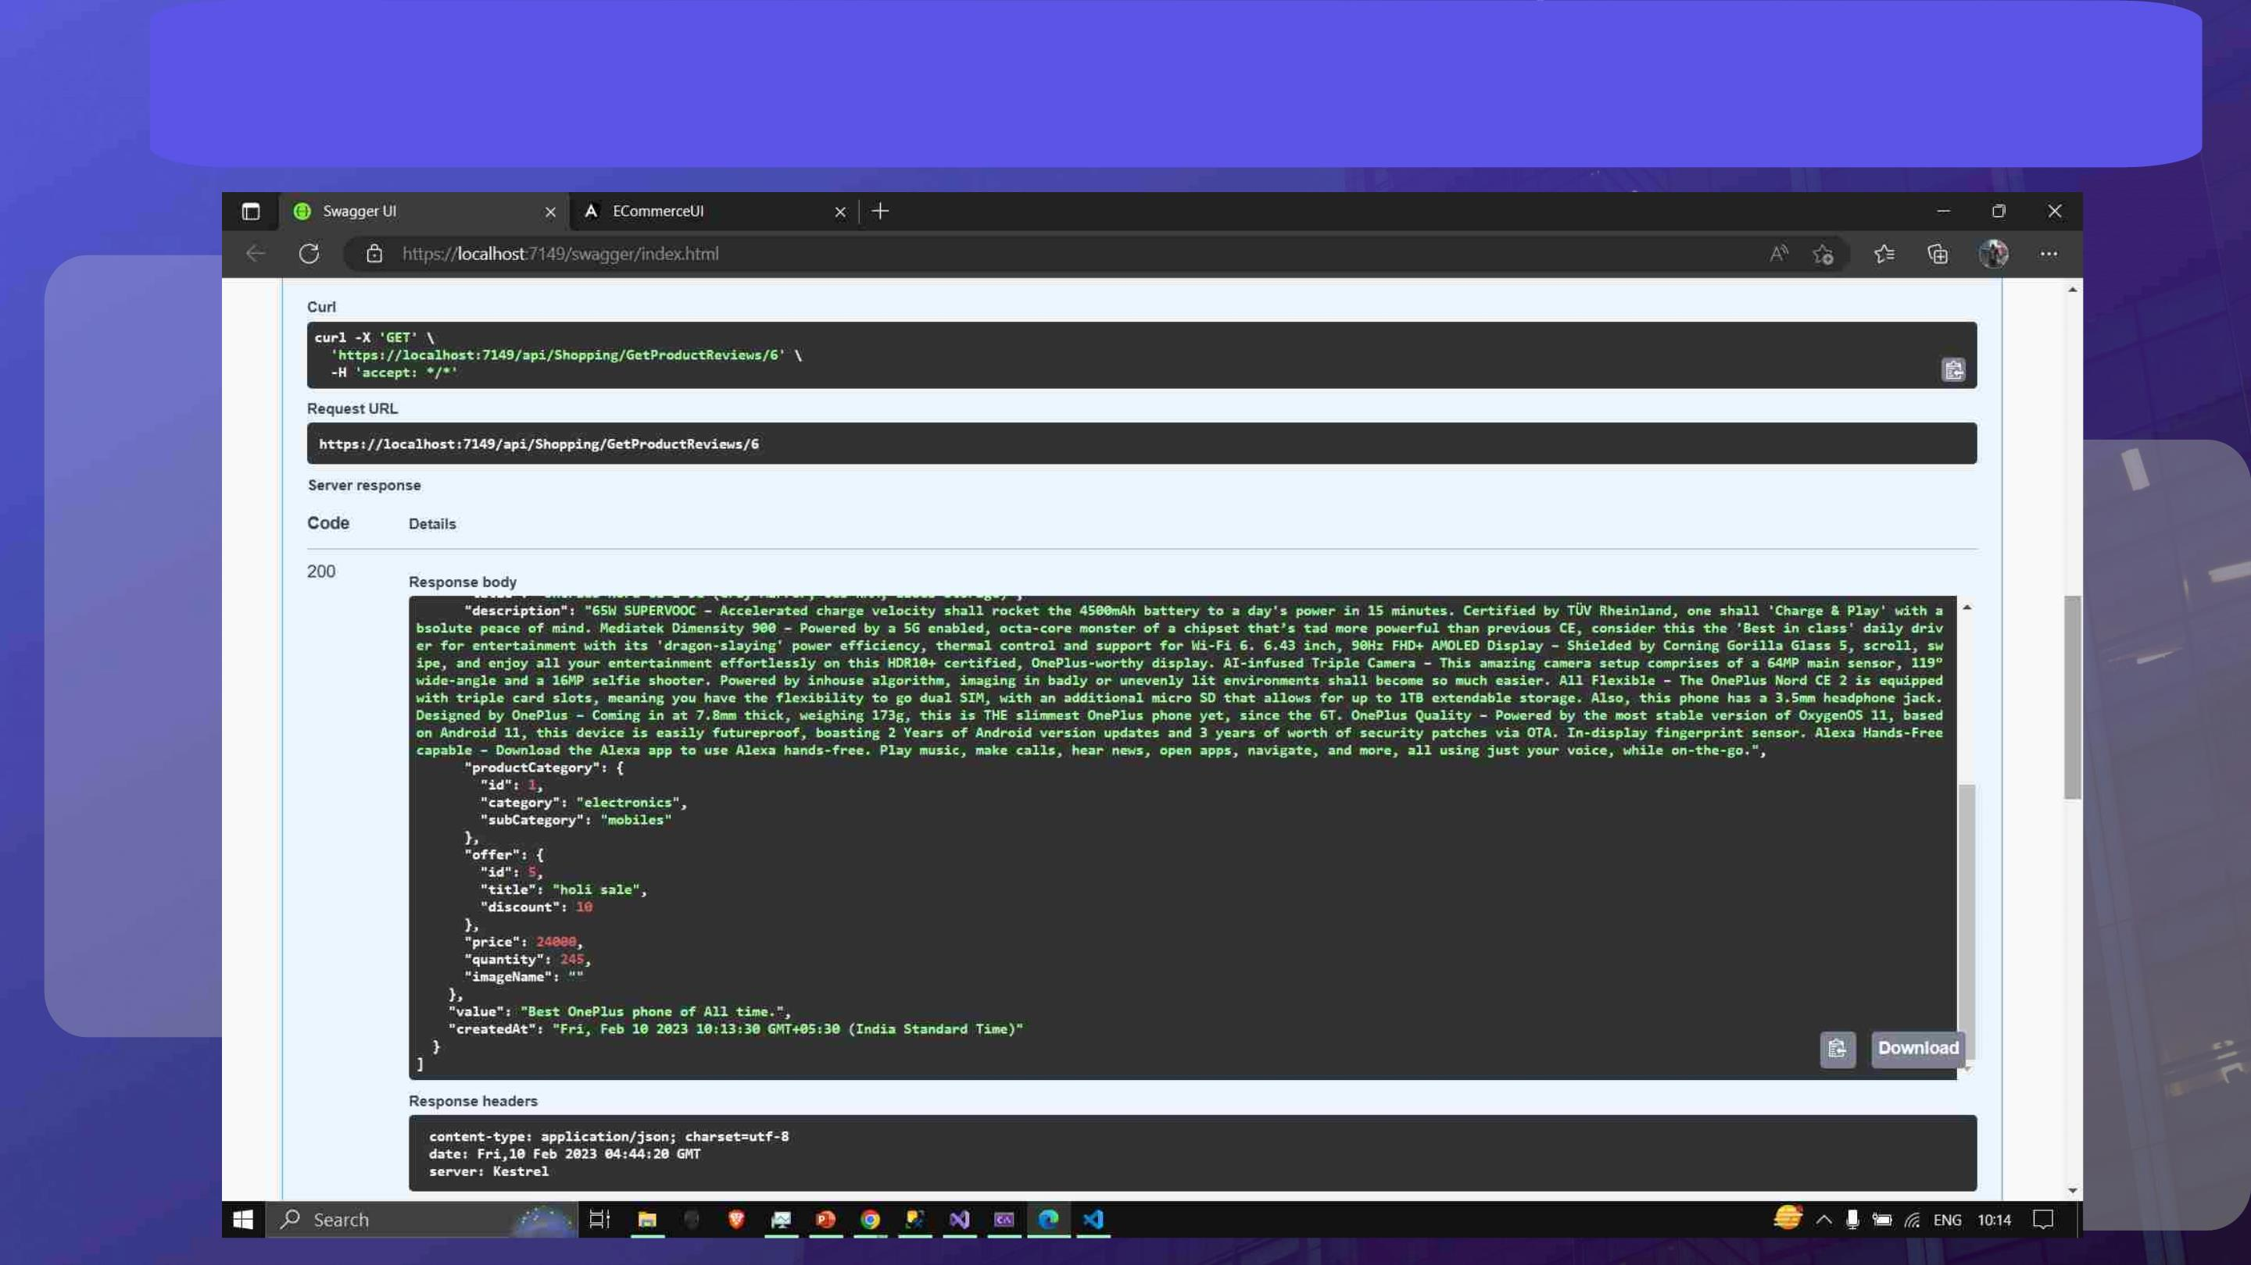
Get Product Reviews

Slide 31

Local Database (SQL Server)
Implementation
• Till now, we have created all the microservices in the in-memory database
which in turn were connected to each other.
• Here, we will demonstrate the local database implementation using SQL server
where we implement the same microservices using a database created in our
local machines, and connected to our respective codes in Visual Studio
Community.

Slide 32
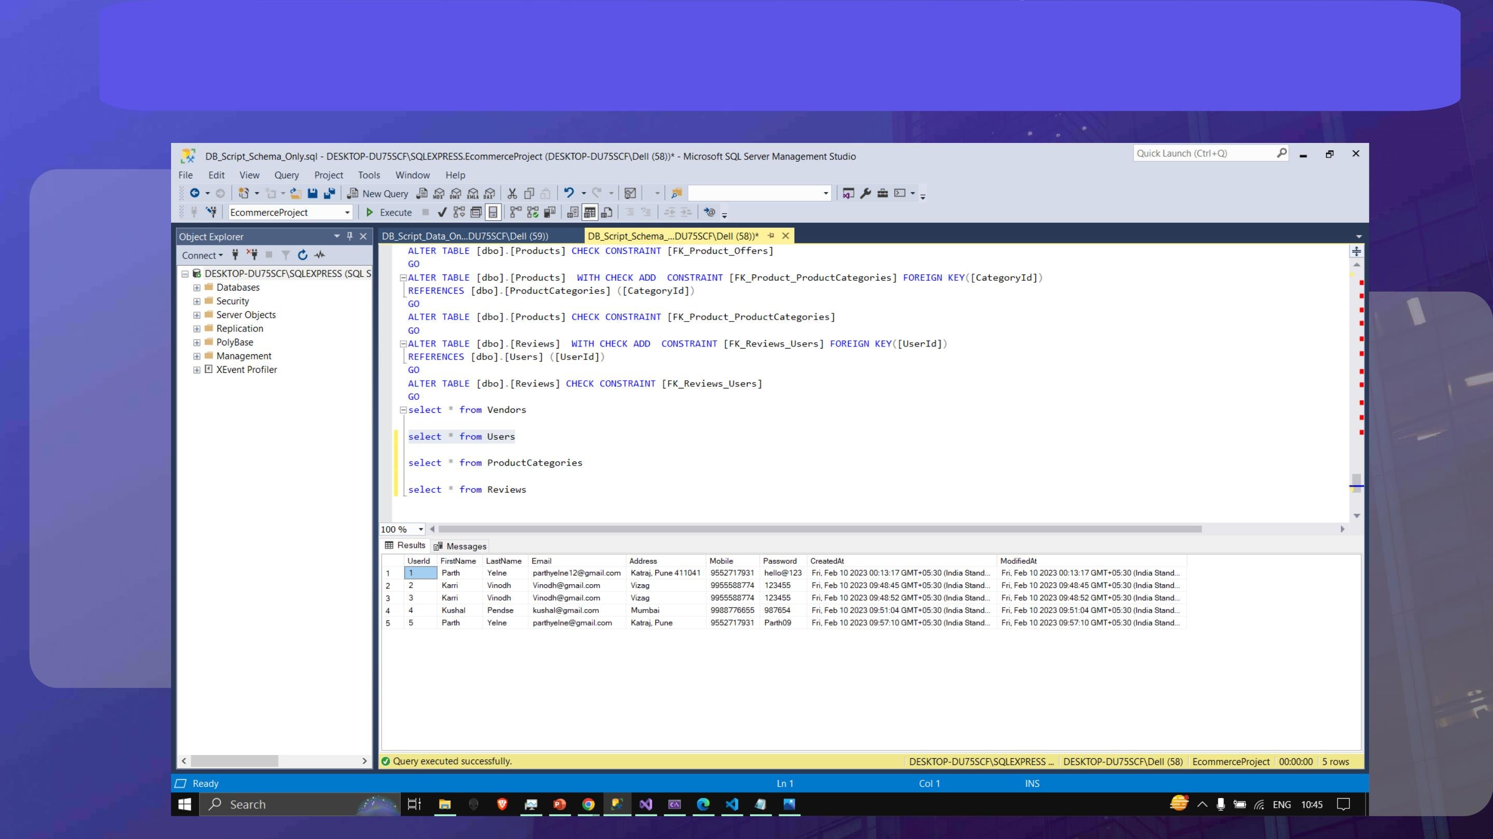
Implementation of Users

Slide 33
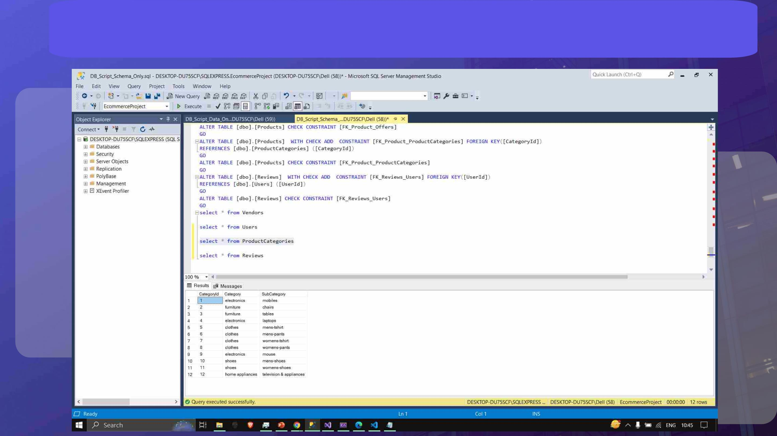
Implementation of Product Categories

Slide 34
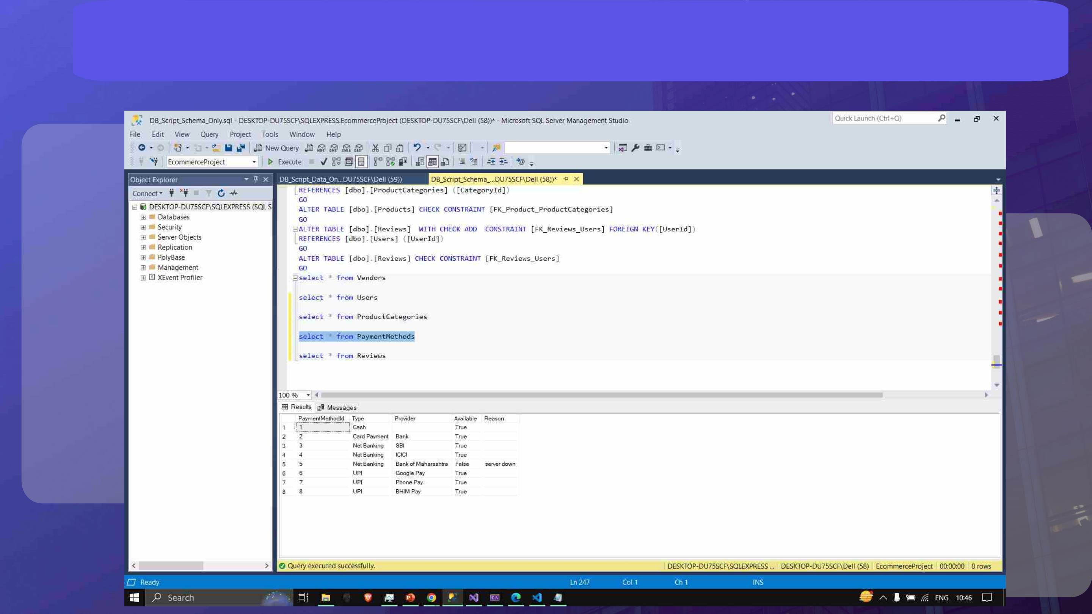
Implementation of Payment Methods

Slide 35
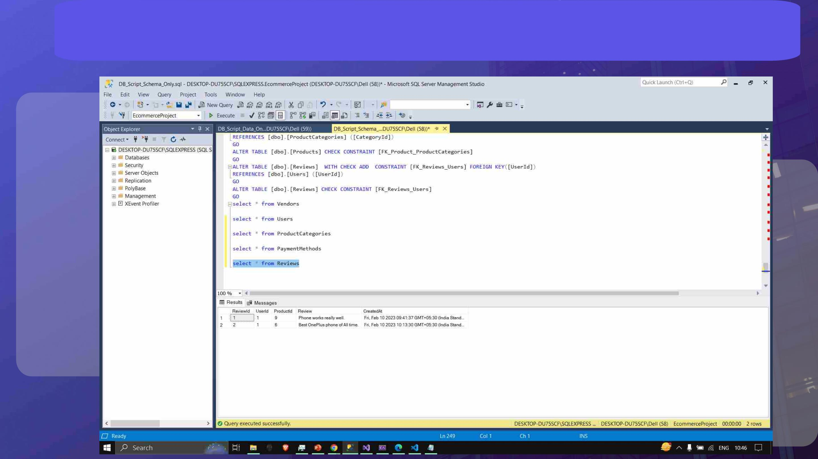
Implementation of Reviews

Slide 36
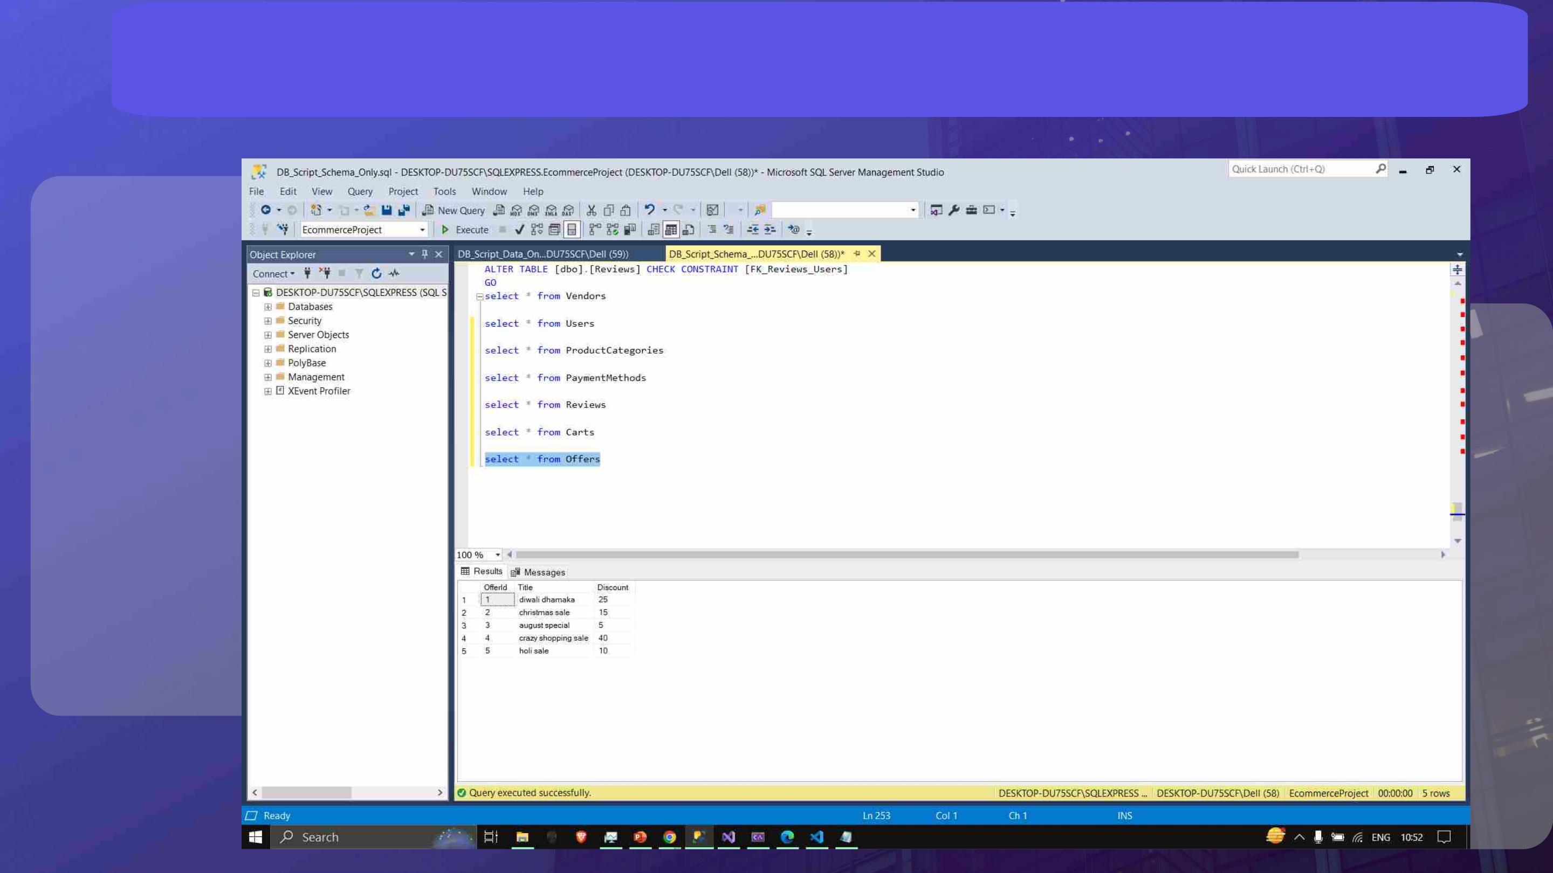
Implementation of Offers

Slide 37

NUnit Testing
• We have successfully performed the Nunit testing, where individual
components of the application are tested to determine whether they
are suitable to use.
• For Cart module in Local DB, it was tested and correlated with their
functional correctness.

Slide 38
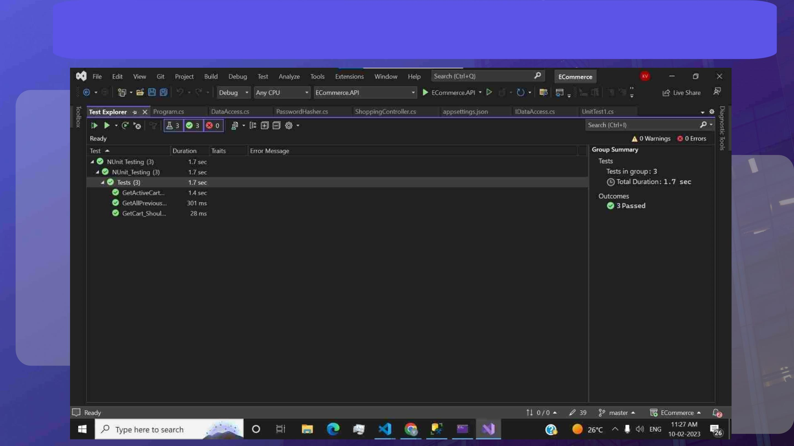
NUnit Testing

Slide 39
The User Interface Portal
• The UI portal is performing the following functionalities.
• Loads the UI and takes care of user sessions.
• Relies on all other microservices for core functionality.
• User various front end development tools to give structure and design to
the web application and perform the user interface functions.
• We will be demonstrating our User Interface in the upcoming slides.

Slide 40
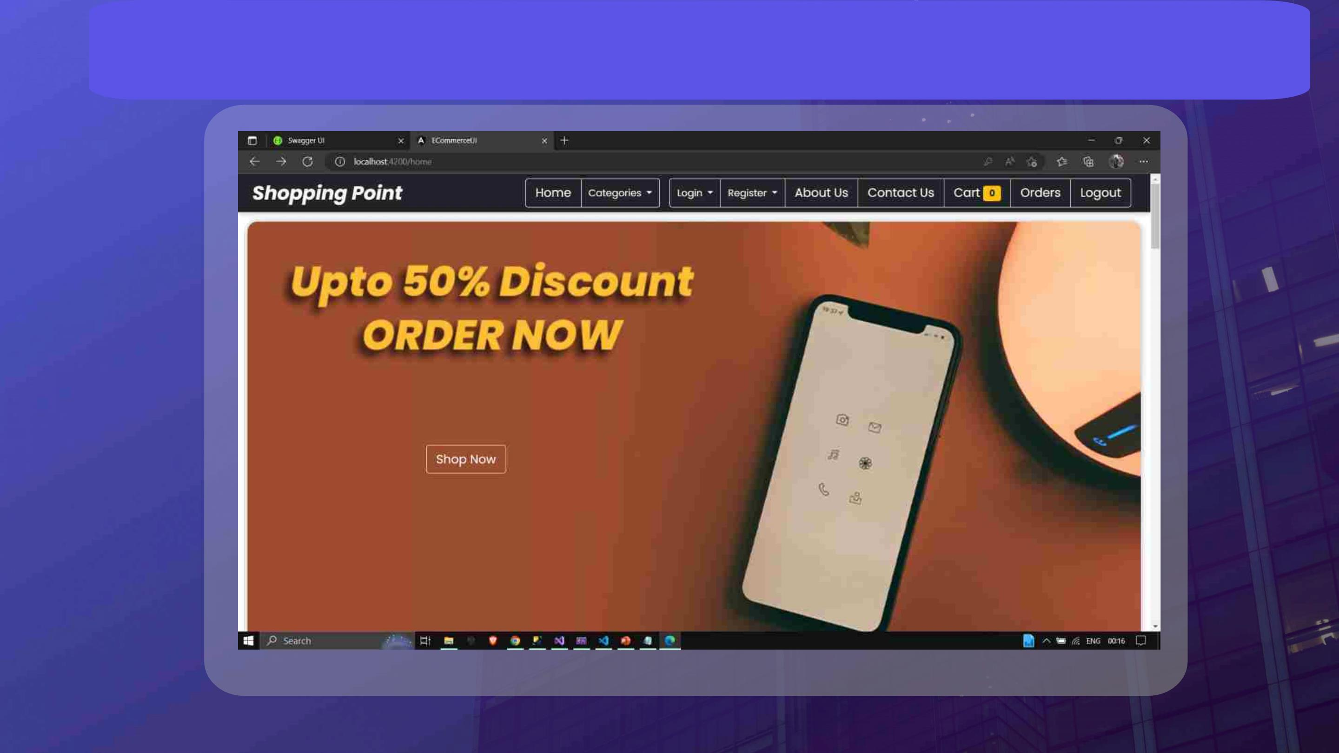
Home Page

Slide 41
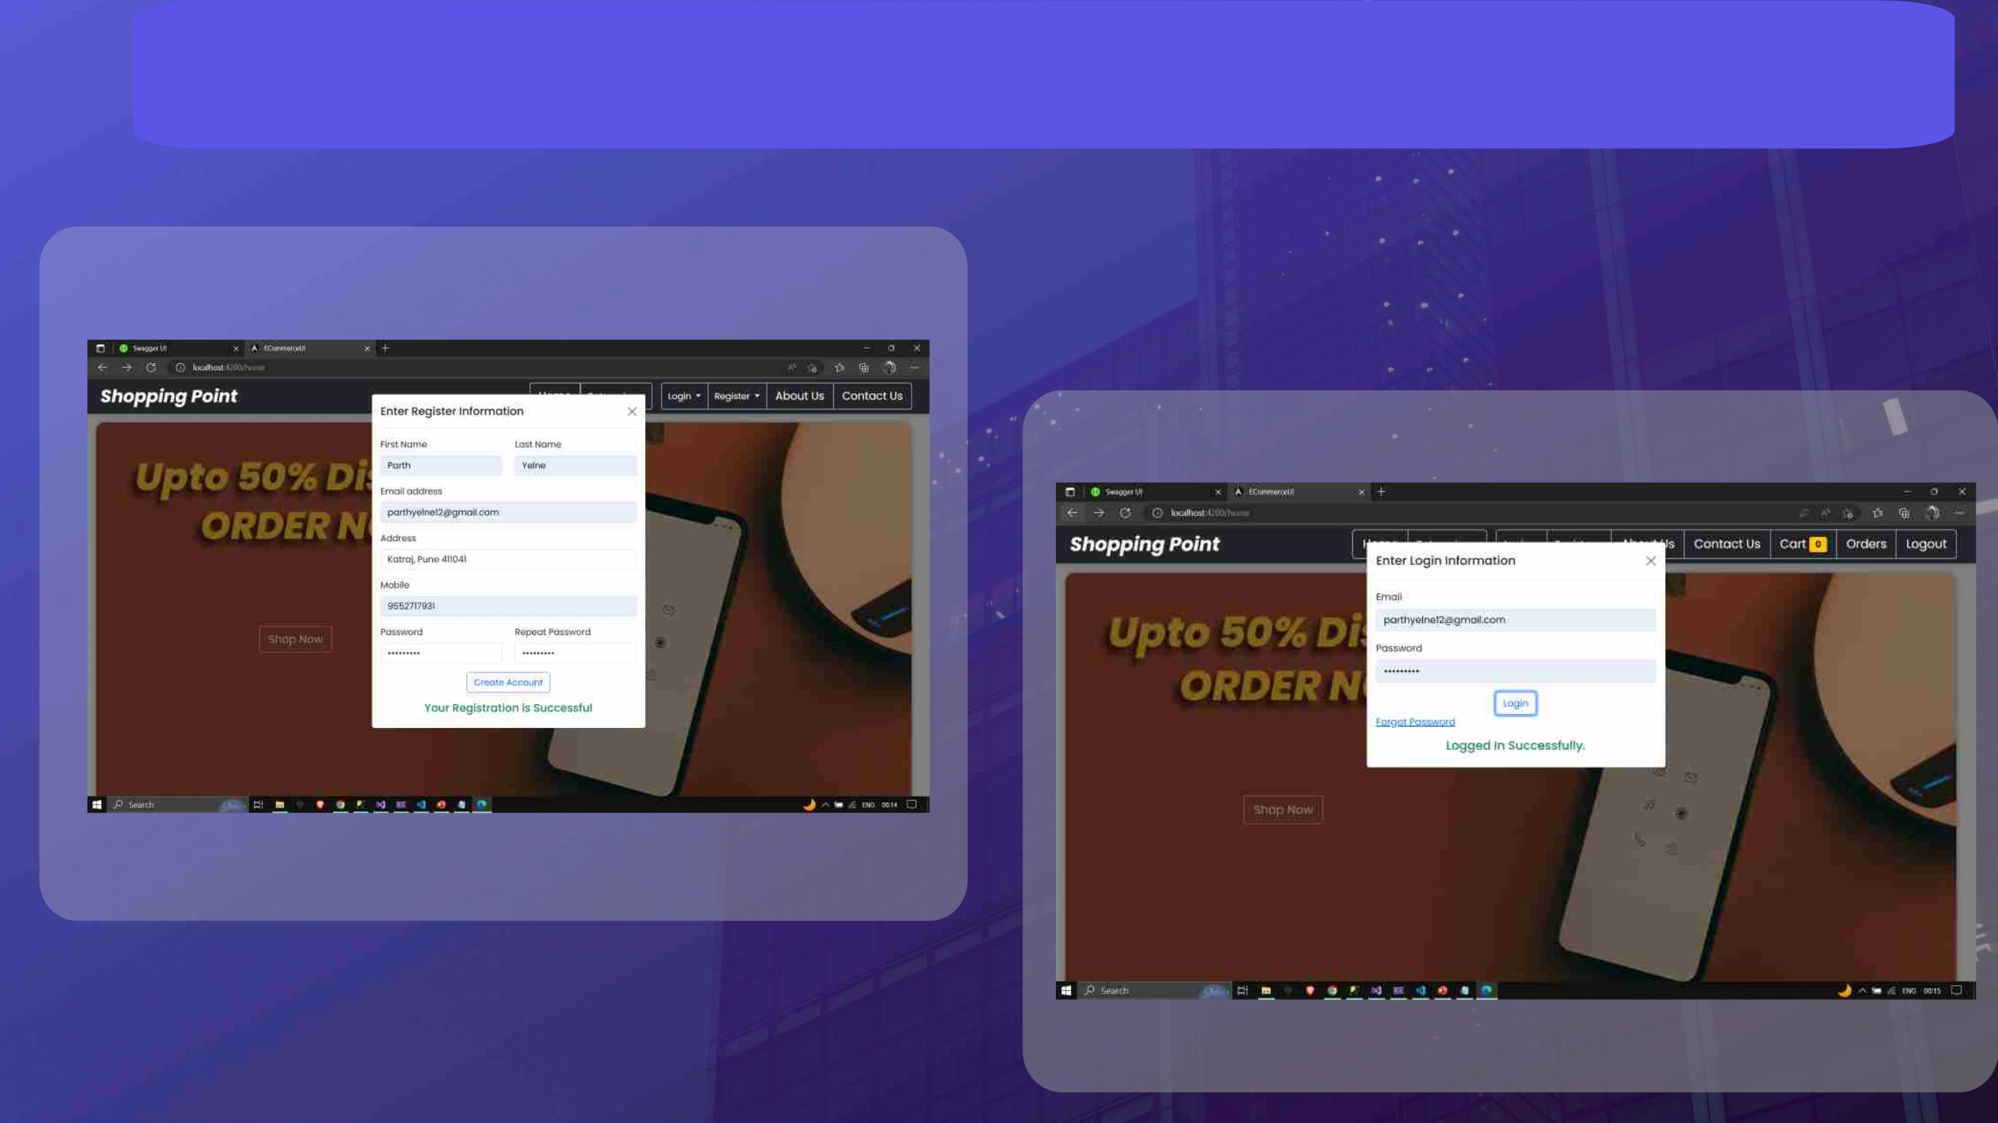
Customer Login

Slide 42
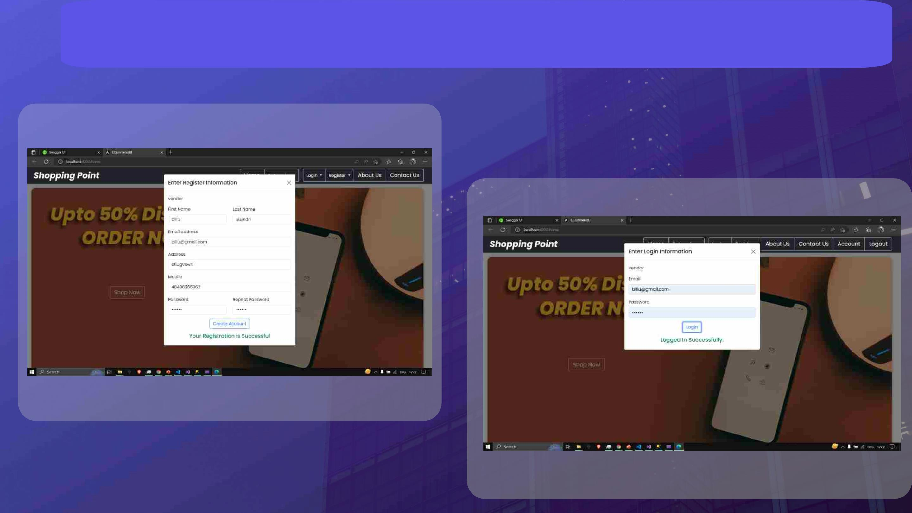
Vendor Login

Slide 43
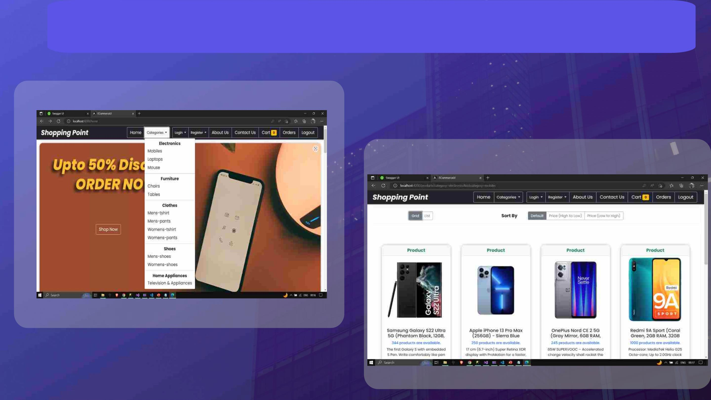
Product Catalog

Slide 44
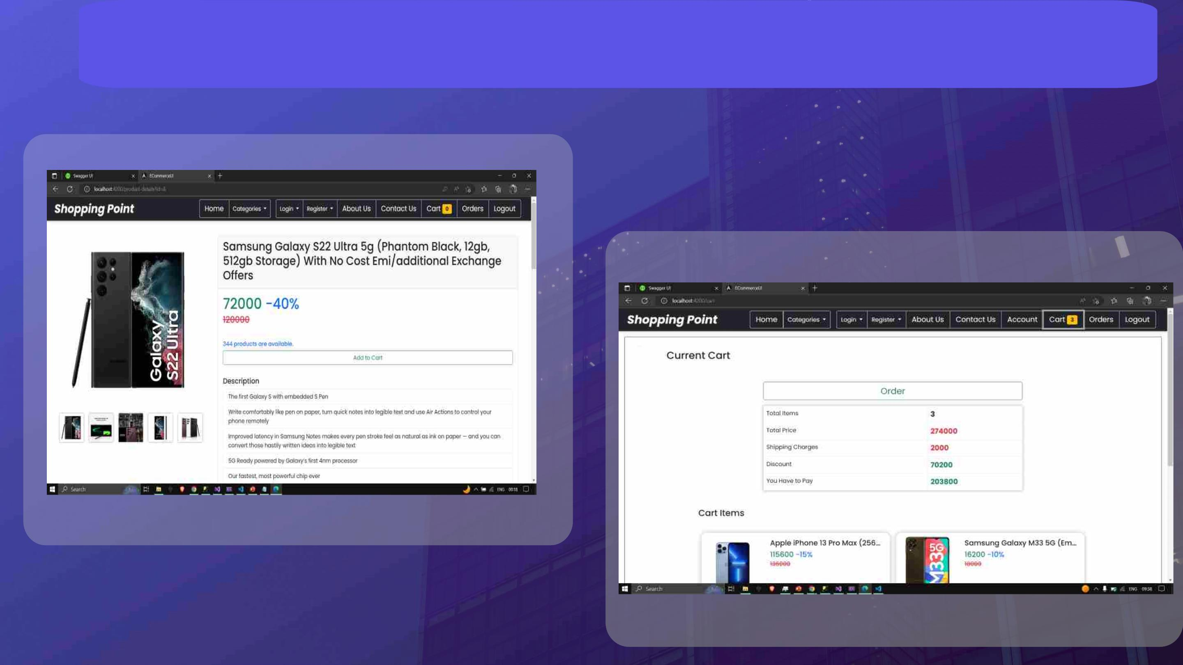
Product Description and Cart

Slide 45
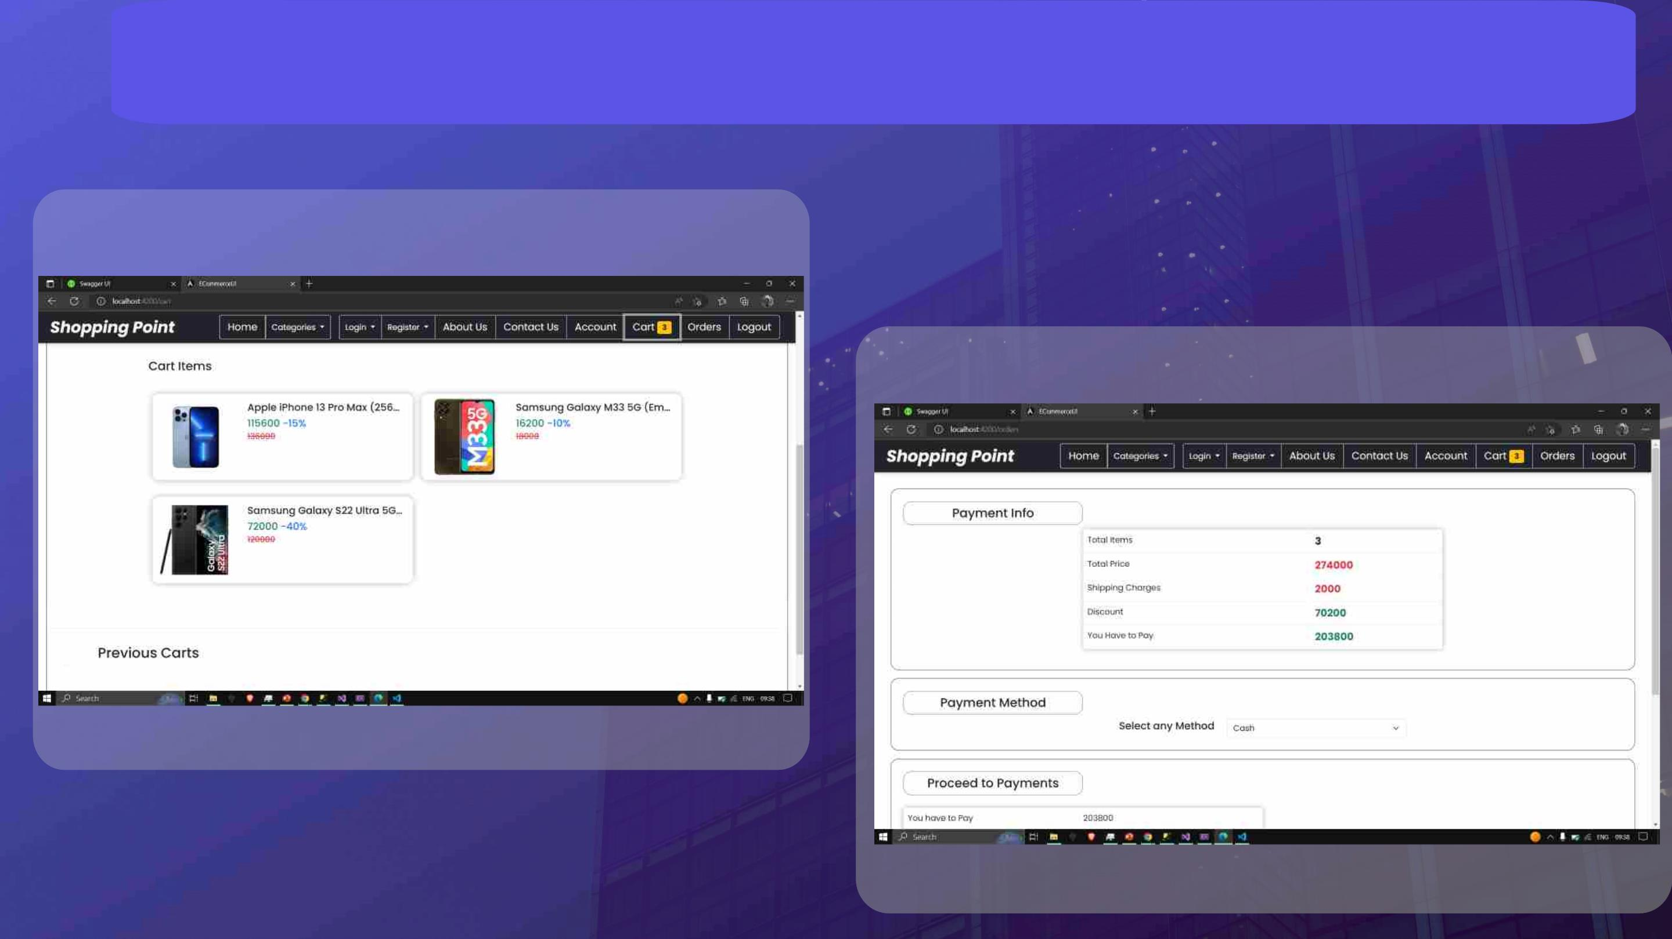
Orders and Payment Info

Slide 46
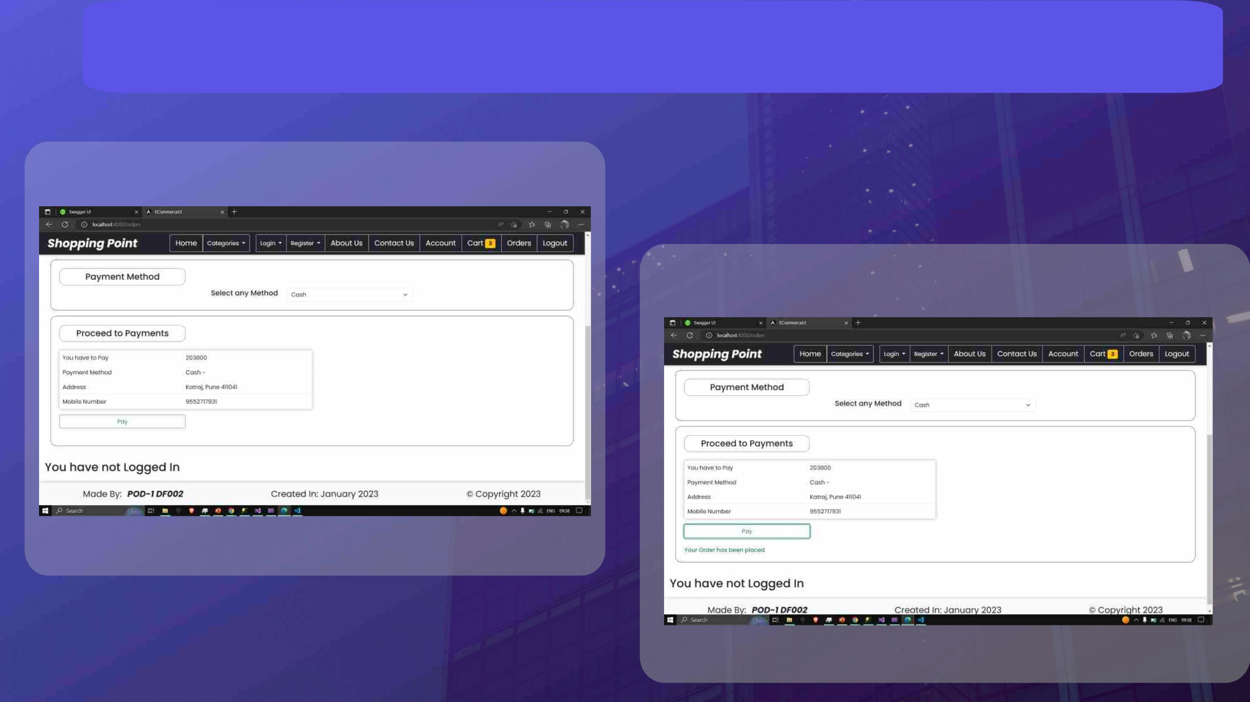
Placing the Order

Slide 47
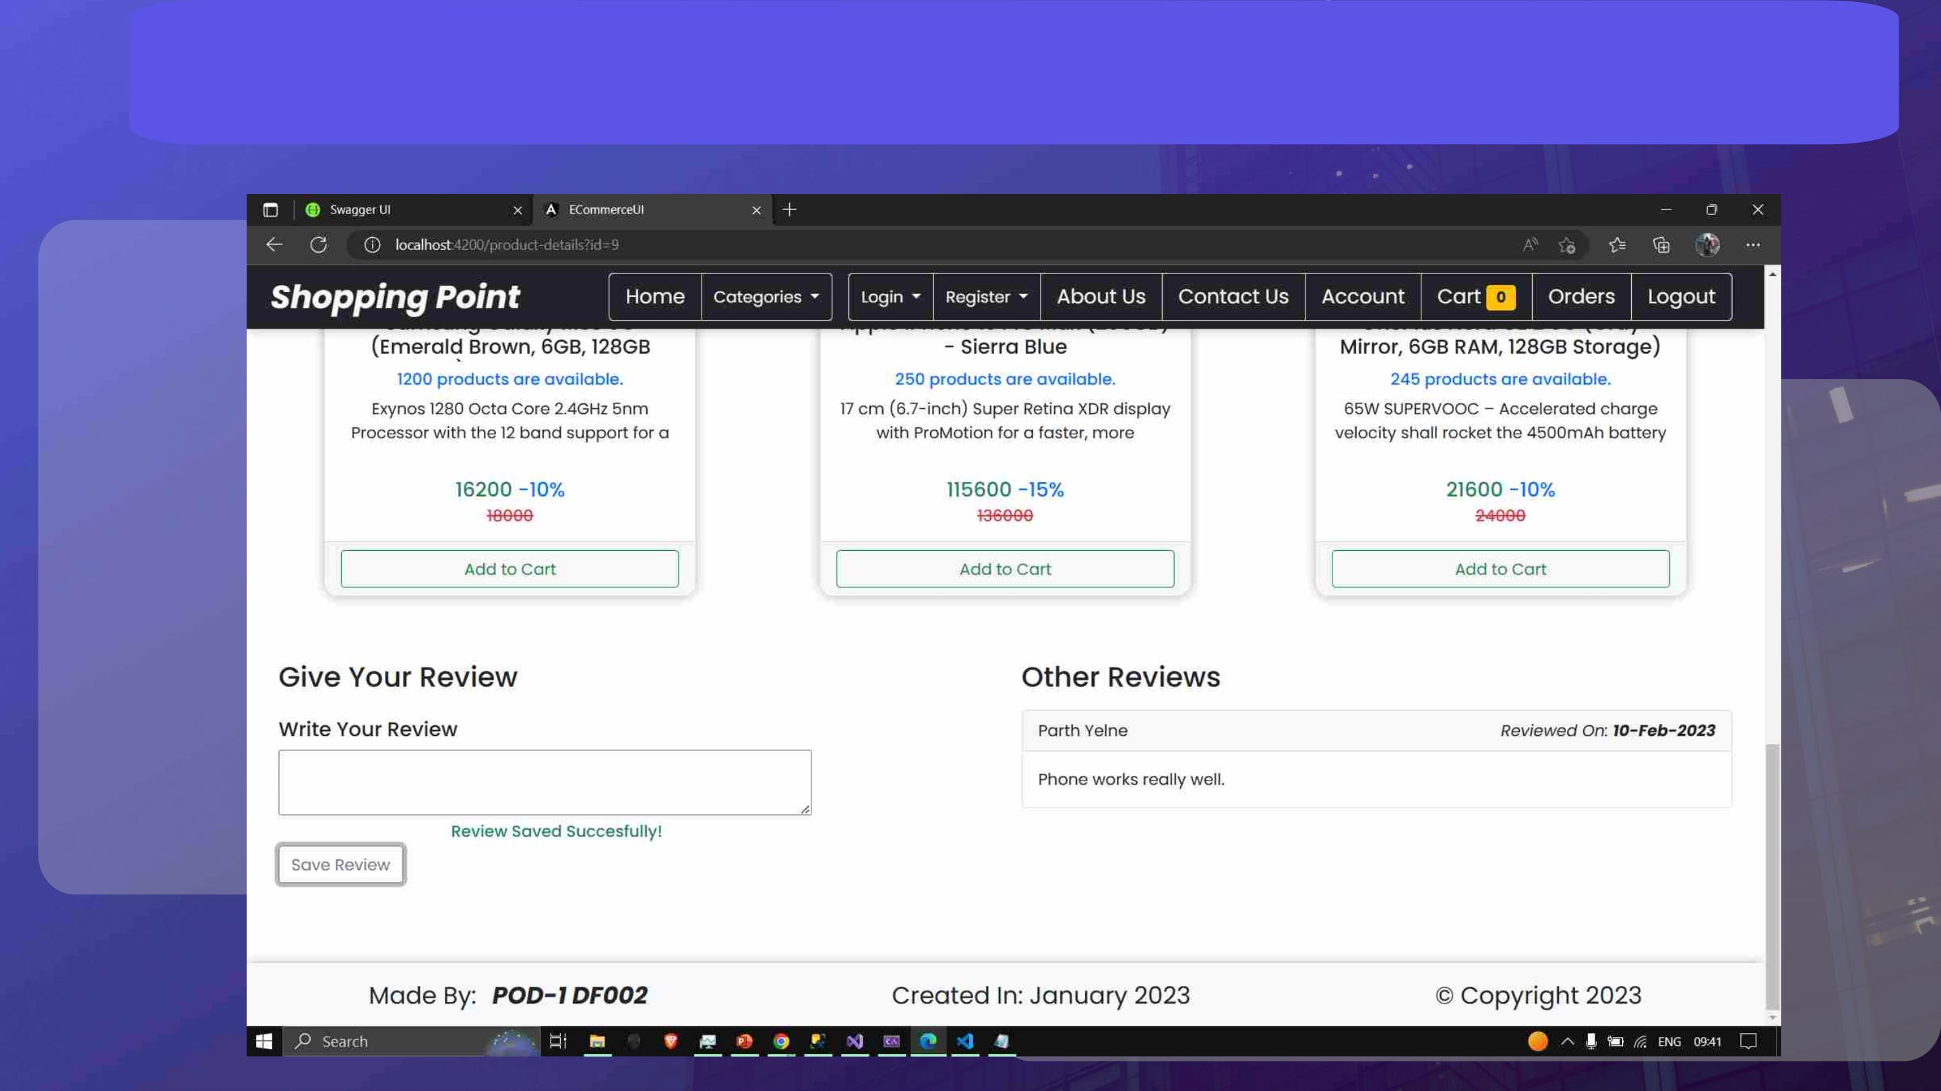
Product Review

Slide 48
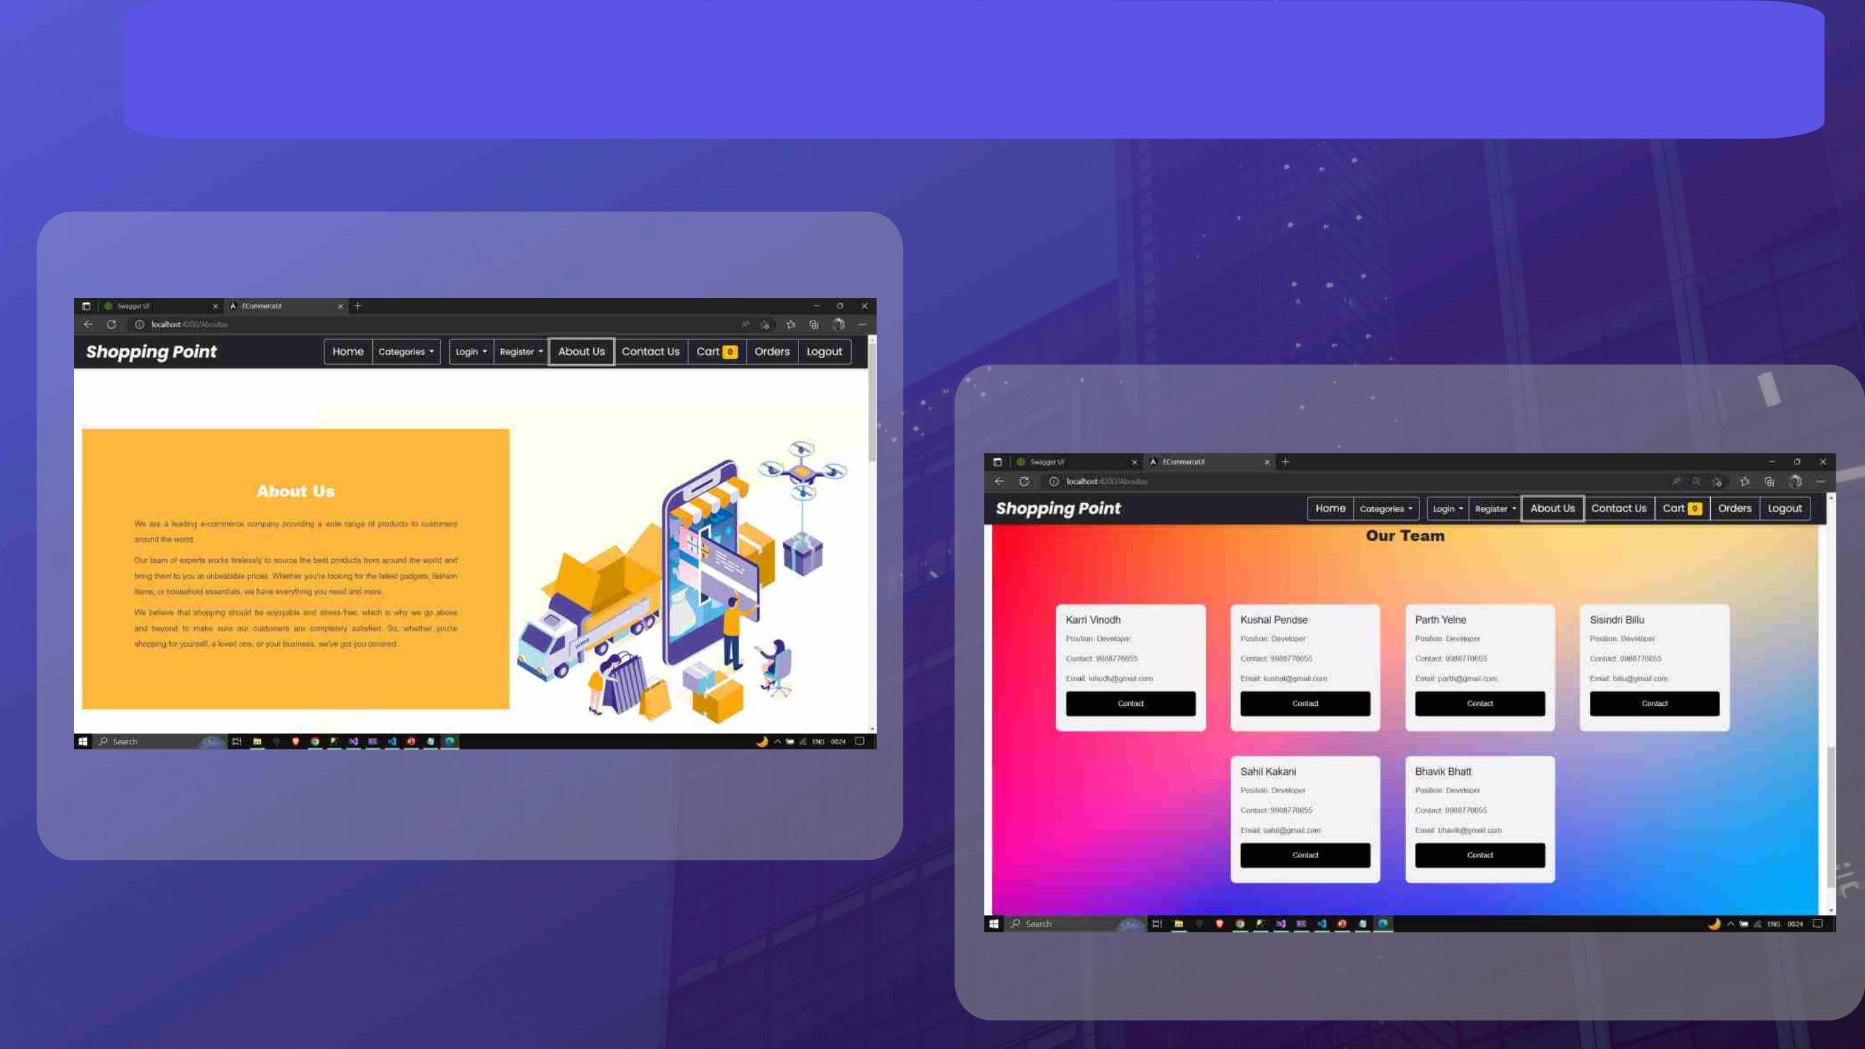
About Us page

Slide 49
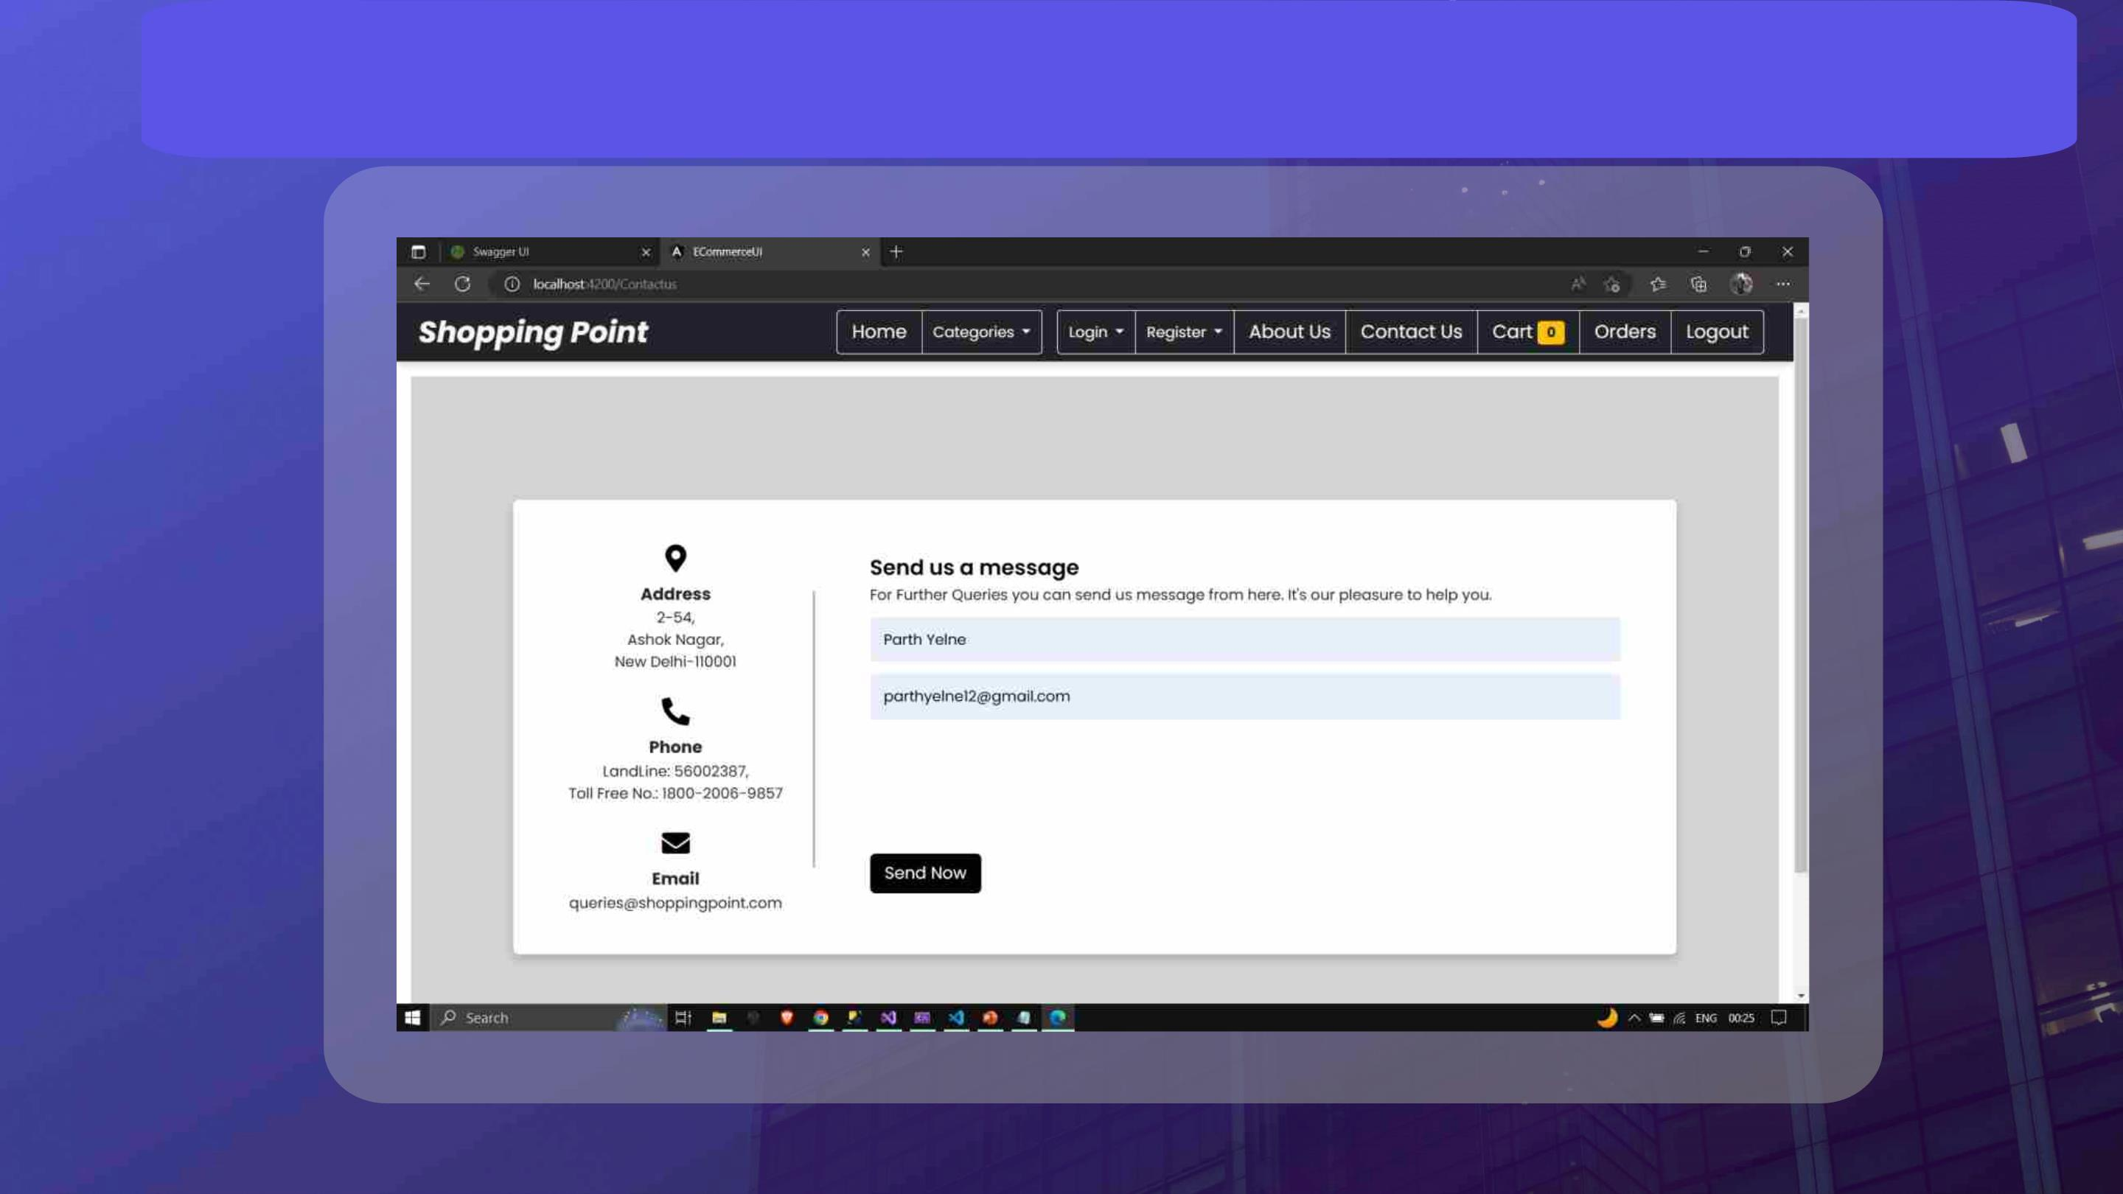
Contact Us Page

Slide 50

THANK YOU

